Slide 1
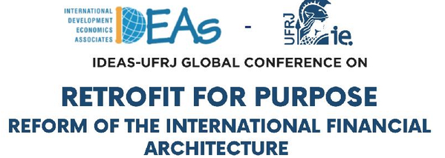
Financing Development in an Unequal World
Jan Kregel

Slide 2
Adam Smith Wealth of Nations:
Government exists to protect real property:
“The acquisition of valuable and extensive property, therefore, necessarily requires the establishment of civil government.”
“Wherever there is great property, there is great inequality.”
“Civil government, so far as it is instituted for the security of property, is in reality instituted for the defence of the rich against the poor, or of those who have some property against those who have none at all.”
Does development of the wealth of nations have to benefit the rich nations at the expense of the poor?

Slide 3
Modern (post-war) Development Theory
It was the 14-18 War that launched modern development theory!
Keynes – Economic Consequences of the Peace
Rosenstein Rodan – Develop Self-sufficiency for newly created nation states via Big Bang - Big Push
Neoliberal “Geneva School” “Globalists”: Restore prewar Rule of markets to counter the postwar Democratic nation states:
Free Trade, Free Capital flows, Gold standard (Slobodian)

Slide 4
Keynes – Economic Consequences
The immense accumulations of fixed capital which, to the great benefit of mankind, were built up during the half century before the war, could never have come about in a society where wealth was divided equitably. …
Thus this remarkable system depended for its growth on a double bluff or deception. On the one hand the labouring classes accepted from ignorance or powerlessness, … into accepting, a situation in which they could call their own very little of the cake that they and nature and the capitalists were co-operating to produce. And on the other hand the capitalist classes were allowed to call the best part of the cake theirs and were theoretically free to consume it, on the tacit underlying condition that they consumed very little of it in practice.
There are pitfalls … lest the cake be after all consumed… , I seek only to point out that the principle of accumulation based on inequality was a vital part of the pre-war order of society and of progress as we then understood it, … which it may be impossible to re-create. …
The war has disclosed the possibility of consumption to all and the vanity of abstinence to many. Thus the bluff is discovered; the labouring classes may be no longer willing to forgo so largely, and the capitalist classes, no longer confident of the future, may seek to enjoy more fully their liberties of consumption so long as they last, and thus precipitate the hour of their confiscation.

Slide 5
Keynes and the “Geneva School” Globalists
The pre-war system was based on : “interference of frontiers and of tariffs was reduced to a minimum, … The various currencies, which were all maintained on a stable basis in relation to gold and to one another, facilitated the easy flow of capital and of trade to an extent the full value of which we only realise now, when we are deprived of its advantages. Over this great area there was an almost absolute security of property and of person.”
The maintenance of this system was the objective of what Slobodian calls the neoliberal “Geneva School”
Dominium and Imperium: Global economic laws supercede domestic political democracy for capitalists to defend their wealth and prevent the “hour of their confiscation”
Economic laws of the market: Open trade, capital flows, Gold Standard
Quinn Slobodian Globalists: The End of Empire and the Birth of Neoliberalism

Slide 6
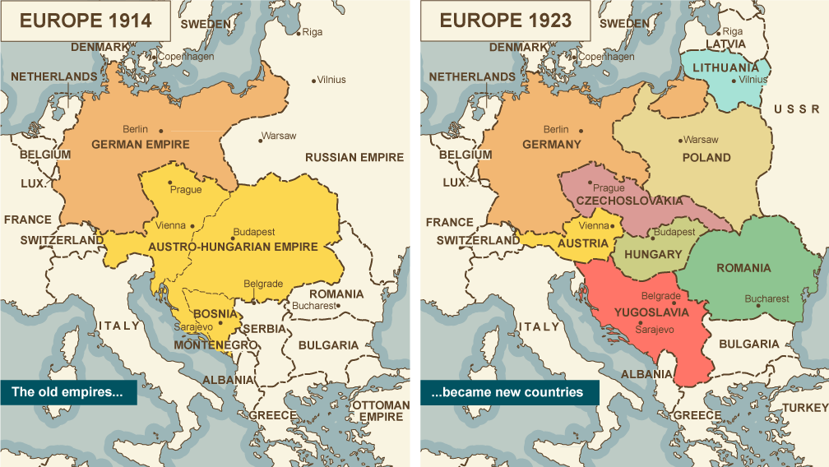
Modern Development Economics stems from Rosenstein-Rodan’s early interest in complementarity and the hierarchy of wants led to concern with the problem of how to create self-sustaining economic systems from the divided remnants of the dissolved Empires

Slide 7
Rosenstein Rodan on the other hand
– “development” == solving the problem created by the new political structure after Versailles
Disrupted existing productive structures (we now call them supply chain disruptions)
Optimal production area ≠ optimal currency area ≠ optimal political area
How to develop self-sustaining productive structures in these new economic areas
By political creation the new nation states had unbalanced productive structures
First priority – internal structural production balance
Required finance (a risk diversified Regional financial trust)
It required a Big Push, or a Big Bang or Balanced sectoral Approach
This was not Soviet style quantitative planning!
It was microeconomics -- based on recognition of substitution and complementarity in the Keynesian Multiplier

Slide 8
Rosenstein-Rodan began …with studies on the frontiers of the Austrian theory of consumer demand -- the concepts of complementarity in consumption and production, the time sequence of economic adjustments, and economies of scale.
“The seeds of my development analysis had been planted earlier …in the themes of complementarity and of the hierarchical structure of wants, together with the role of time-that is, the choice of an economic period over which an individual allocates his scarce resources.'
The dynamics of wants and their interrelatedness were much more important to me than the neoclassical attempt at precise characterization of the properties of the utility function. Consumption complementarities, the role of time, the pursuit curve, plus external economies-all these dynamic factors were not to be considered as a second order of smalls, but even more as pervasive in a less developed country.
Not traditional static equilibrium theory but an analysis of the disequilibrium growth process is what is essential for understanding economic development problems.”

Slide 9
My thinking during the 1940s and 1950s led to the theory of the "big push." "There is a minimum level of resources that must be devoted to . .. a development program if it is to have any chance for success.”
Complementarity in production and consumption requires initiating a broad spread of activities in different sectors – or a Big Push
“This theory of the big push contradicts the conclusions of traditional static equilibrium theory in three respects. First, it is based on a set of more realistic assumptions of certain indivisibilities and nonappropriabilities in the production functions. These give rise to increasing returns and to technological external economies.
Second, the theory is meant to deal with the path to equilibrium. At a point of static equilibrium net investment is zero. The theory of growth must be very largely a theory of investment.
Third, in addition to the risk phenomena and imperfections characterizing investment, the markets in underdeveloped countries are even more imperfect than in developed countries. The price mechanism in such imperfect markets cannot therefore be relied upon to provide the signals that guide a perfectly competitive economy toward an optimum position.
Underlying the need for a big push is the pervasiveness of rural underdevelopment-excess agrarian population. Given that mass migration and resettlement are not feasible, I stated that "The movement of machinery and capital towards labor, instead of moving labor towards capital, is the process of industrialization which, together with agrarian improvement, is the most important aspect of the economic development of the depressed areas."
Industrialization has to be promoted not because of terms of trade, but because external economies are greater in industry than in agriculture alone. Rejecting a strategy of self-sufficiency or an inward-looking strategy of industrialization, I argued for industrialization with the help of international investment and for a pattern of industrialization that would preserve the advantages of an international division of labor and would therefore, in the end, produce more wealth for everybody.”

Slide 10
So who won?
Wilson and the League – self-determination coupled nicely with Rosenstein-Rodan’s idea of national self-sufficiency
But the Globalists were busy inside the League promoting free trade, capital flows and the return to the gold standard
Globalism became “multinationalism”:
New nations signed away their domestic policy autonomy to multinational organisations
GATT – trade and tariff rules becomes WTO rules based playing field
IBRD –private capital flows with government and multinational guarantee
IMF – ersatz gold standard to produce exchange rate stability -- based on external equilibrium
Extragovernmental imposition of market adjustment
We now talk about the “External Constraint” on developing countries –
Here it is: It is the Globalisation of Geneva School rules

Slide 11
“Keynesian” Support of Global Employment Hansen-Gulick and Kindleberger
“Former methods of foreign lending and investment are no longer suitable from the standpoint of either the lending countries or the borrowing countries. New machinery must be devised. The relatively new device of the Government Corporation or the Government Authority might very well be assigned a major role. A sort of International Recontruction Finance Corporation to stimulate foreign investment.
On the one side, there will be need for an international public development corporation to promote large-scale projects in industrially backward countries and areas; on the other side for an international authority under which private corporations seeking foreign investment outlets could obtain minimum guarantees based on the principle of insurance… “
“The Economic Tasks of the Postwar World,” Alvin H. Hansen and C. P. Kindleberger Foreign Affairs, Vol. 20, No. 3 (Apr., 1942), pp. 466-476 Published by: Council on Foreign Relations
“I believe there will be need in the postwar years for three new international economic institutions, one to take care of monetary stabilization, a second to expand international capital investment, and another for the control of prices of primary products.”

Slide 12
Hansen: The International Development and Investment Bank
The International Development and Investment Bank, should be to provide funds for develop­ment projects and for capital outlays on equipment and plant necessary to develop the agriculture and industry of the econom­ically backward areas.
… It is important to lay a sound basis for private capital lending and investment in foreign countries. This the [US] Treasury proposal also stresses as a guiding principle. … the bulk of foreign capital investment should and can consist of private loans and invest­ments.
… in addition, loans and investments should be made by the Bank itself in cases where private funds cannot and will not enter. … in the absence of basic developmental projects, financed by public funds, private investments in many cases could not be undertaken.
Private funds could be encouraged …by two types of procedures already familiar through the Federal Housing Administration. … Under the F.H.A. plan, the homeowner must supply … equity money; the remainder … financed by mort­gages insured and guaranteed by the F.H.A. … These insurance pre­mium payments are pooled by the F.H.A. and serve as a first buffer to guarantee the mortgages held by private institu­tions. If this pool should be exhausted … the Treasury guarantees the mortgages. The owner of the mortgage is, however, required …to foreclose on the prop­erty; only if the foreclosure does not adequately protect his mortgage will the insurance and guarantee be utilized.
… The Bank could insure and guarantee loans, charging the borrower an insurance premium and a service charge in addition to interest … to create confidence in foreign financial investment. In addition, encouragement of equity investment via a yield insurance on the entire investment in which case there would be no mortgages whatever.
The Bank itself would have to undertake to make loans and participate in direct investment for approved capital projects in foreign countries. The projects would be undertaken by the foreign government itself or by private industry guaranteed by it.
The funds provided by the Bank could be raised by issue guaranteed bonds in the various private capital markets of the world. A second source would be the Bank's own capital funds subscribed by the various participating governments.
“World Institutions for Stability and Expansion,” Alvin H. Hansen, Foreign Affairs , Jan., 1944, Vol. 22, No. 2 Published by: Council on Foreign Relations

Slide 13
Neoclassical theory for NeoLiberal approach to “Development”
“The basic argument for international investment of capital is that under normal conditions it results in the movement of capital from countries in which its marginal value productivity is low to countries in which its marginal value productivity is high and that it thus tends toward an equalization of marginal value productivity of capital throughout the world and consequently toward a maximum contribution of the world’s capital resources to world production and income.”
Pace the Cambridge Capital Controversies
Jacob Viner, “International Finance in the postwar World,” Journal of Political Economy, 55, April, 1947, p. 98.

Slide 14
So “Geneva” multinationalism sets the external constraint on development policy Law of the Market == Rule of Law that overrides the political process --
But today the Environmental Crisis is clearly a “global” problem
We still recommend “global governance” to solve the problem
International Financial Architecture is based on private bilateral debt flows intermediated in private financial markets
The solution to the financing of the solution to the climate crisis is also private market finance

Slide 15
it is not only a “border” problem
Climate Damage is a debt pusher – it forces countries to borrow
Banks create money out of nothing; climate change creates debt out of nothing
Think of a hurricane as a mafia offer you can’t refuse
Or as a debt to “Gaia” accumulated over time
Accumulates faster for countries with lower means to Remediate
Geography: SIDS, Production: climate dependent Agriculture
No Policy remedies: Good macro policies won’t help
Not only generates a Maldistribution of debt
But also of populations, of water: drought, flood, turbulence
We can do something about the people, not the water
But emergency financing remains on a bilateral basis
And remediation creates contingent debt with no source of debt service
Is there an asset to match the Climate debt

Slide 16
How does this system deal with Climate Change?
Remediation/Reparation of Environmental Damage
For low-income countries requires extraordinary budget expenditures
Think of the hurricane as a “Sovereign” Climate creditor
Reparation may require imports of foreign technology/materials: foreign borrowing
This creates a contingent or “double debt” burden
No SDRM is possible with the hurricane – you have to pay now with emergency services and repairs
So no temporal restructuring is possible
No SDRM is possible with Sovereign creditor “Gaia”
The response is Climate remediation
Which requires borrowing from developed countries
Climate Improvement does not generate debt service
It is pure Ponzi finance

Slide 17
Climate and Global MalDistribution of “Fiscal Policy Space”
While remediation costs of climate damage are random across borders, the fiscal space to respond is not.
Climate crisis like the devolution of the Empires after the 14-18 War – There are new climate boundaries but they roughly correspond to developing countries
Developed countries have the fiscal space to use traditional “Keynesian” expenditure policies to support domestic incomes.
Lerner: the major impact of internal borrowing is domestic redistribution of income; . “The proper analogy to the incurrence of internally held national debt is not an individual borrowing from another individual but an individual borrowing money from one of his pockets to put it into another. ”
The basic difference between internal and external deficits: “Increasing debt to other countries or to the citizens of other countries does indicate impoverishment of the borrowing country and enrichment of the lending country. … The country cannot by monetary manipulations consume more than it can produce.”

Slide 18
Remedy the Global MalDistribution of “Fiscal Space”
While climate damage is random across borders, the fiscal space to respond and offset the internal costs is not.
For Developed countries
Traditional “Keynesian” expenditure policies can be used to respond to climate change.
As Lerner pointed out long ago, as long as debt is held internally the major impact is one of domestic redistribution of income:. “The proper analogy to the incurrence of internally held national debt is not an individual borrowing from another individual but an individual borrowing money from one of his pockets to put it into another. ”
For Developing Countries
have limited fiscal space and rely on foreign borrowing:
“Increasing debt to other countries or to the citizens of other countries does indicate impoverishment of the borrowing country and enrichment of the lending country. … The country cannot by monetary manipulations consume more than it can produce.”
“repayment {of foreign currency debt} will constitute a real burden on the country just as the borrowing provided a real benefit quite different from any benefit that can accrue from internal borrowing. When the time comes to make the repayment there may be great inconvenience which could lead to default. But none of these considerations is at all applicable to internally held national debt which from the point of view of the nation cancels out.”
This means that there is a differential burden on developing countries responding to the crisis in terms of the real costs of servicing the external debt.
While debt ratios have been further aggravated in all countries by the increasing interest rates led by developed countries’ central banks to offset the impact of these events on inflation rates, this further increasing the differential burden placed on developing related to developed countries.

Slide 19
Differential burden
This means that there is a differential burden on developing countries responding to the Climate crisis in terms of the real costs of servicing the external debt to fund reconstruction and remediation.
While debt ratios have been further aggravated in all countries by the increasing interest rates led by developed countries’ central banks to offset the impact of these events on inflation rates,
this further increases the differential burden placed on developing related to developed countries.

Slide 20
Another example
Developed countries’ financial institutions facing domestic/international financial crisis
Losses absorbed by issue of domestic government debt
To support domestic financial stability
Minsky’s Two masters --
Developing countries’ financial institutions facing domestic/international financial crisis are not bailed out by government support but allowed to fail or are absorbed by developed country financial istitutions

Slide 21
Try an Old Idea: multilateralism
Since the problem is not so much the costs of meeting the challenges of global climate change – they have to be met and they are real, the basic problem is the global distribution of these costs created by the fact that developed countries can deal with them via creation of internal deficits and debt while this is not available to developing countries. This means the problem has to be dealt with on the level of a global financial institution.
We could think of this as designing the global financial system on the pattern of a domestic system, so the question is simply one of looking at the equitable distribution of costs between developed and developing countries.
This would mirror the approach Keynes used for a global clearing union based on the extension of what he called the “banking principle” from the national to the international level.
We can think of this as the mirror of Lerner’s affirmation that government debt creating deficits cannot produce a real cost since there is always a necessary equality of debits and credits. In such a system, the debts and credits are always internal to the global clearing system and costs are redistributed.

Slide 22
BW Equilibrium = Differential (downward) global adjustment
Balogh: the unrestricted multilateralism on which the I.M.F. is based is incompatible with maximum progress in the less fortunate areas of the world if this instability cannot be overcome by international action.
Kalecki-Schumacher: It may be questioned whether the very concept of equilibrium --- There is no merit in a general policy aiming at current account equilibrium for all countries, because different countries are at different stages of economic development,
equilibrium can result by exerting pressure upon surplus countries to buy more and/or to sell less, or by exerting pressure upon deficit countries to sell more and/or to buy less. … there is little reason to believe that any international machinery aiming at equilibrium would be able to attain its end without ·equilibrating downwards.
Dangers of disequilibrium, could be overcome if a mechanism is created whereby countries can have any surpluses they may like if reserve funds are not strictly limited.
The simplest solution, would be to adopt the British plan, to abandon the concept of quotas.
The International Clearing Union would then be a purely formal institution with no influence upon member countries, its function being merely to settle the ultimate outstanding balances between central banks.
It would not aim at 'equilibrium' of any kind; it would not be concerned with the size of balances to be settled; it would merely keep the big ledger in which is recorded how much some nations owe to others.

Slide 23
Kalecki –Schumacher “multilateral solution”
Both the British and the American plans envisage the creation of two separate agencies: one for 'current trade' and one for 'investment’.
Only by combining both into one organization can a satisfactory solution be found for the problems of both.
Use coordination of capital flows rather than penalties to limit current account imbalances. The proposed amendment to the British plan amounts, therefore, to this:
1. An orderly supply of purchasing power to deficit countries through long-term lending by the International Investment Board is made possible;
2. The question of long-term lending is separated from, and made independent of, the liquidity wishes of surplus countries. Surplus countries may accumulate any credit balances they like; they are even given some inducement to do so by being enabled to earn interest on accumulated balances.
3. To meet the special conditions of some deficit countries the granting of development loans may be made conditional upon the loan money being used wholly or partly for additional purchases from these deficit countries. Such apportionment of development loan purchases away from surplus countries and towards certain deficit countries may be regarded as interfering with the free play of market forces, but in this respect it would not differ from tariffs, quotas, and other established techniques of control, and it would be applied only if other means of restoring equilibrium are likely to fail.
Our scheme applies the apportionment principle only to additional demand generated by development loans, and aims simultaneously at providing 'unbalanced equilibrium' for developing countries, liquidity for surplus countries, and current account equilibrium for mature deficit countries.
Kalecki and Schumacher “International Clearing and Long-Term Lending” (1943)

Slide 24
Shifts response from bilateral to multilateral adjustment and sharing costs of adjustment
Dangers of disequilibrium, could be overcome if a mechanism is created whereby countries can have any surpluses they may like if reserve funds are not strictly limited.
The simplest solution, would be to adopt the British plan, to abandon the concept of quotas.
Financial institutions actions limited by defence of owners’ equity
IMF quotas are the equivalent of owners’ equity reserve funds
Policy will be to preserve owners’ equity on a bilateral basis
Programme funds fully repaid – by downward adjustment to equilibrium
Balogh, Kalecki, Schumacher amendment to Keynes’ clearing proposals
shift to support on a multilateral basis
By upward adjustment and global preservation of income and employment

Slide 25
Thank you
jankregel.org

