Slide 1

"Prospects for the Introduction of a Global Clearing Union
Who’s Afraid of Keynes’s Clearing Union?
Jan Kregel

Slide 2
Alternative Theory: Money is “nothing”
Schumpeter taught us that:
  “It is always a question, … of the creation of new purchasing power out of nothing – out of nothing…”
But, he forgot to tell us that “money” was “not a thing”
William Petty (1623-87) knew this:
  “Mony is an artificial Thing or rather No Thing … but Is rather ye Sign of a Thing. For If men were excellently Versed in accompts Mony were not necessary at all and many places as Barbados &c have made shift without it & and so they do in Banks.”

Slide 3
Point 1: Money is a notional Unit of Account: It is not a commodity!
Luigi Einaudi called it “Imaginary” money-- He noted that medieval monetary systems were based on purely notional or “imaginary” units of account that did not reflect any historical existent “real” metal coin or physical commodity money:
  “The imaginary or account money, the libra or livre or lira of old, was … even more abstract than a paper note, an image, or mirror, reflecting money; it was a mere “ratio". The price of a good is, indeed, not a material thing. … it is an abstract ratio. … The device of imaginary or account money came gradually to be adopted all over Europe between the ninth and eighteenth century as a convenient way of stating that the price of merchandise is a ratio between a given quantity of that article of merchandise in a given quantity of another.”
Einaudi, Luigi (1937). “The Medieval Practice of Managed Currency.” In A. D. Gayer (ed.), The Lessons of Monetary Experience. New York: Rinehart.
Keynes: “Now for most important social and economic purposes what matters is the money-of-account; for it is the money of account which is the subject of contract and of customary obligation.” (Keynes: CW: 252-3, Vol XXVIII)
Schumpeter: “In this method of obtaining a – basically random – unit of account as well as of entitlement, lies, as we shall see, the core of the institution of money of the profit economy,” (Treatise on Money: 109)

Slide 4
Point 2: Money is the Netting of Debits and Credits: Clearing Houses
Colwell:
  Banking is “a system by which men apply their credits to the extinguishment of their debts. … This is in direct contrast with the cash or money system, in which every article is either paid for in the precious metals at the time of delivery, or at some time afterwards. These two systems work side by side.” (The Ways and Means of Payment, 1859: 188–89)
Schumpeter:
  “But logically, it is by no means clear that the most useful method is to start from the coin — … It may be more useful to … look upon capitalist finance as a clearing system that cancels claims and debt and carries forward the differences—so that ‘money’ payments come in only as a special case without any particularly fundamental importance.” (History of Economic Analysis, 717)
Mitchell Innes:
  “Banks are the clearing house of commerce.”
Hartley Withers: Loans make Deposits
  “[m]ost of the money that is stored by the community in the banks consists of book-keeping credits lent to it by its bankers. It is usually supposed that bankers take money from one set of customers and then lend it to other customers; but in most cases the money taken by one bank has been lent by itself or another bank,” and that “the greater part of the banks’ deposits consist, not of cash paid in, but of credits borrowed. For every loan makes a deposit.” ( 1906,46, 51)

Slide 5
All monetary economists knew this
Classical Economists:
Smith (1776): “Buying and selling upon credit, and the different dealers compensating their credits with one another, … will supply {physical money} with less inconveniency” than barter. “
Ricardo (1816): instead of gold being used in exchange “money is merely written off one account and added to another”; so payments may be “effected without the intervention of either bank notes or money.”
NeoClassical Theorists:
Jevons: “a far more potent source of economy is what we may call the Cheque and Clearing System, whereby debts are, not so much paid, as balanced off against each other. The germ of the method is to be found in the ordinary practice of book credit.”
Walras: “the idea of settling a certain number of daily exchanges by means of the following procedure. People who have a credit account at a bank buy and sell commodities all day long to or from each other, just paying by means of receipts on their bank called cheques. Between 5.00 p.m. and 6.00 p.m. the bankers meet and compensate their clients’ debts and credits and each of them supplies in money only the surplus of cheques written over those he received, or obtains in money only the excess of the cheques he received over those he wrote. Purchases and sales are also made by credit,” e.g. “the compensation of cheques between banks, in clearing houses, has as a result that things take place as if all exchangers had the same bank, in the sense that, where a cheque is brought to the credit of one client and at the same time to the debit of another, its handing over does not bring any transfer of money with it;

Slide 6
Keynes’s monetary theory:
Treatise on Money chapter 1 Paragraph 1:
”Money-of-Account, namely that in which Debts and Prices and General Purchasing Power are expressed, is the primary concept of a Theory of Money. A money of account comes into existence along with debts, which are contracts for deferred payment, and price lists, which are offers of contracts for sale or purchase. Such debts and price lists, whether they are recorded by word of mouth or by book entry on baked bricks or paper documents, can only be expressed in terms of a money of account. Money itself, namely that by delivery of which debt contracts and price contracts are discharged, and in the shape of which a store of general purchasing power is held, derives its character from its relationship to the money of account, since the debts and prices must first have been expressed in terms of the latter.”
“the introduction of a money of account gives rise to two derived categories—offers of contracts, contracts and acknowledgments of debt, which are in terms of it, and money proper, answering to it, delivery of which will discharge the contract or the debt.”

Slide 7
Keynes’s: “bank money”
“Bank money is simply an acknowledgment of a private debt, expressed in the money of account, which is used by passing from one hand to another, alternatively with money proper, to settle a transaction.” (Ibid. 5)
This leads to “the discovery that for many purposes the acknowledgments of debt are themselves a serviceable substitute for money proper in the settlement of transactions.
When acknowledgments of debt are used in this way, we may call them bank money—not forgetting, however, that they are not money proper.
This bank money of account is liberated from any physical or commodity form and reflects what Luigi Einaudi has called “imaginary money”⁶. Bank money of account serves as money proper when it is the object of action of bankers “entering debits and credits in their clients’ accounts.“ Bankers managing clients’ accounts denominated in money of account thus replace gold or bank notes as the “primary concepts” of monetary theory and substitute for the quantity theory of prices.

Slide 8
From International Currency and Finance to “Notes on Ancient Currency“ to Tract to Treatise
Keynes worked on International Monetary Reform his entire career from Versailles to Bretton Woods
He also worked on an alternative to the Quantity theory of Money from the Tract on Monetary Reform to the General Theory
Keynes’s alternative monetary theory based on the netting of bank money in a clearing house – “the banking principle”— scaled up from the single bank, to the national level and then to the international level to form a global Currency Union

Slide 9
Currency Union is “Banking Principle” on global scale
Keynes: “The idea underlying such a Currency Union is simple, namely, to generalise the essential principle of banking, as it is exhibited within any closed system. This principle is the necessary equality of credits and debits, of assets and liabilities. If no credits can be removed outside the clearing system but only transferred within it, the Union itself can never be in difficulties. It can with safety make what advances it wishes to any of its members with the assurance that the proceeds can only be transferred to the clearing account of another member.
Its problem is solely to see to it that its members keep the rules and that the advances made to each of them are prudent and advisable for the Union as a whole.” (Horsefield, 3)

Slide 10
Schumacher’s Amendment: Multilateral Pool Clearing
Replicates the Payment System of trade bills under the Gold standard
Gold did never moved – it was always domestic netting of exporters selling their claims on foreigners at a discount to domestic bankers who sold them to importers who used them to discharge their payments to foreigners paid by the foreign correspondent of the domestic bank.
Short-term capital flows, not gold flows, interest rate differentials, not international price differentials produced stability under the gold standard (See Keynes Tract on IRPT))
National Clearing Funds
Every member country creates a National Clearing Fund.
Importers make payments in domestic currency into the National Clearing Fund. The Fund notifies the National Clearing Fund of the exporter that payment has been received.
The National Clearing Fund of the exporter makes payment in domestic currency.
Each National Clearing Fund thus receives and disburses domestic currency:
  it receives such currency from the home importers and disburses it to the home exporters.
Clearing Funds of deficit countries will have a positive domestic cash balance;
  It neutralises impact on internal monetary policy buying Treasury bills in the open market;
Clearing Funds of surplus countries would be short domestic cash and could sell Treasury bills in the open market.
In this way National Clearing Funds would operate in a manner analogous to that of an Exchange Equalisation Account.

Slide 11
“International Clearing Office - ICO” Acts as Trustee for the aggregate cash balances accumulated by National Clearing Funds in the form of national Treasury Bills.
The Assets of the ICO are “owned” as investments by the National Clearing Funds of the surplus countries on a pro rate basis give by relative surpluses. Sort of a global hedge fund.
Automatic global capital flows finance global deficts.
The ICO:
  requires no finance of its own – no country quotas, no capital contribution
  does not create a new international currency – no bancor
  Removes $, removes gold from international settlement system.
Since it is impossible to disentangle the mass of individual transactions which give rise, during the course of business, to the various uncleared balances in the deficit countries and to ascribe any one particular balance, or part of it, to any one particular surplus country, all the surplus countries the joint owners of the balances in all the deficit countries.
In this way, every national currency is made into a world currency,
Nor does the ICO require any special powers; it is not an agency for control, but a purely administrative body, the central clearing office for the different National Clearing Funds.

Slide 12
Alternative Limits on Imbalances:
As a result of its (purely formal) operations, we get the following position: The Clearing Funds of surplus countries become indebted to their internal money markets and acquire an equivalent share in the ICO Pool; both their debt and their share in the Pool being equal to their trade surplus. The Clearing Funds of the deficit countries are left with balances of cash in hand (equal to their trade deficits) which belong to the International Pool. The Clearing Funds, finally, of countries in external balance hold neither cash nor a share in the Pool.
In difference from Keynes’s original proposal of interest penalties on excessive imbalance, ICO Clearing places quantitative limits on the size of a country’s global credit or debit balance.
Schumacher recommends setting a limit on a country’s debit balance, which leaves the potential credit balance variable – i.e. it depends on the overall distribution of creditor and debtor countries and the limits placed on the latter countries.
The main force limiting the size of the net creditor position “is the fact that the holding of surpluses becomes unprofitable and risky. The surplus, instead of being convertible into gold or interest-earning investments, is tied up in the Pool: it is a share in the Pool. And the Pool's assets are always the weakest currencies of the world : the currencies of the countries that have been unable to earn as much as they have spent.

Slide 13
Beyond Currency to International Investment
“From the beginning, Mr. Keynes … was willing to use the proposed International Clearing Union for … long-term purposes:
The Union might set up a clearing account in favour of international bodies charged with post-war relief, rehabilitation and reconstruction.
It might supplement contributions received from other sources by granting overdraft facilities in favour of these bodies, the overdraft being discharged over a period of years out of the Reserve Fund of the Union, or, if necessary, out of a levy on surplus credit balances.
By this means it is possible to avoid asking any country to assume a burdensome commitment for relief and reconstruction, since the resources would be provided in the first instance by those countries having credit clearing accounts for which they have no immediate use and are voluntarily leaving idle, and in the long run by those countries which have a chronic international surplus for which they have no beneficial employment. (cf. Penrose 1953, 43)
Alvin Hansen had made several proposals for an International Investment and Development fund Hansen’s first proposal (1942) used the US experience with the Reconstruction Finance Corporation and subsequently the Federal Housing Administration (1944).

Slide 14
WAR CABINET, COMMITTEE ON RECONSTRUCTION PROBLEMS. EXTERNAL MONETARY AND ECONOMIC POLICY.
Note by the Secretary.
EXTERNAL MONETARY AND ECONOMIC POLICY, WITH SPECIAL REFERENCE TO DISCUSSIONS WITH THE UNITED STATES ADMINISTRATION. NOTE BY THE TREASURY .
Section VI (178 to 190) deals with the proposals of the American professors, Messrs. Hansen and Gulick:
A. To establish an International Economic Board to advise the collaborating Government with respect to internal policy designed to promote full employment economic stability and world trade; this Board to have research staffs in Washington, in London and in Ottawa, and ultimately in other centres, with provision for interchange of personnel.
B. To undertake an International Resources Survey with the active collaboration of all countries for the purpose of exploring the needs and opportunities for internal and regional developmental projects throughout the world.
C. To establish an International Development Corporation in which the capital stock will be subscribed by the American Government, the British Govern­ment, the Dominion Governments and such other Governments as are prepared to participate both with respect to capital subscription and representation on the board of directors; this Development Corporation to sell bonds guaranteed in appropriate proportions by the participating Governments to private investors, and to make capital expenditure through the purchase of shares in local developmental Corporations or Government Authorities in the interest of the general welfare on developmental projects, particularly those explored by the International Resources Survey.
Section VII (191 to 195) deals with Mr. Harrod's detailed plan for associating the Hansen-Gulick proposals with the Clearing Union Plan.
The Board would only accept subscriptions to its issues from the citizens (including corporate bodies) of credit countries. This flow of funds would tend to liquidate their credit. But it must not be supposed that credit countries would gain no benefit except the interest on their loans to the Board. Their exports, and … level of employment, would be stimulated. And at the same time their imports would rise …. In the new situation their credit position would… be reduced, for the loans plus the additional imports (both debits) would exceed the additional exports. It is important to emphasise that the credit countries would not only have found a means of earning interest on their credit balance but also have had their internal employment stimulated. The project countries, and almost certainly also those not subscribing to the loans, would have their debit position reduced.
Thus the Board would have regard to the most advantageous division of labour in the long run and not finance the development of industries inconsistent with that. For instance markets must be left for the export of manufactured goods from countries which cannot provide their own food and raw materials. … considerations regarding the desirable direction of foreign investment are so serious as to give a prima facie case for prohibiting or licensing private foreign investment in the condominium countries.
It has been suggested that we should ask America to control capital movements … If America would not agree to controlling private investment the Board might go far to achieving the same effect (1) by providing money for its approved projects at rates far below those which would attract the private investor and (2), by keeping things sufficiently humming on approved lines to deprive would-be borrowers of their appetite for less desirable projects. Having decided upon the best lines of development the Board would stultify itself fatally if it stinted those lines.

Slide 15
Kalecki/Schumacher Amendment: An International Investment Pool
In an amendment to extend the clearing union to accommodate international capital investment flows (Kalecki and Schumacher, 1943) noted that :
“There is no merit in a general policy aiming at current account equilibrium for all countries, because different countries are at different stages of economic development, and a regular flow of investment from the more highly developed to the more backward regions of the world may redound to the benefit of all. ”
“In order to achieve and maintain a truly international system in the post-war world the International Clearing Union must also assume the function of long-term lending to underdeveloped countries and wield certain additional powers,” such as directed purchase and lending.
The authors go on to recommend that the Board may direct countries to direct their purchases to particular countries to ensure limits on bilateral imbalances, noting that “If investment decisions have to be taken by an international authority, there arises, of course, a political problem of the first magnitude. The mainly administrative functions to be discharged by the Board of the International Clearing Union are, relatively speaking, politically neutral. But investment decisions, and decisions directing a borrower to make his purchases in one particular country, involve a higher degree of political responsibility.”
“International Clearing and Long-Term Lending,” Supplement to the Bulletin of the Oxford Institute of Statistics Vol. 5 August 7, 1943

Slide 16
Implications of Multilateralism
1. Noted by Schumacher – no identifiable bilateral current account or debt imbalances so no misplaced policy for adjustment
2. No Capital contributions; no country quotas
3. Most importantly no commitment to bilateral balance
  Under BW link of $ to Gold, exchange rate parity commitment meant bilateral current account balances had to be controlled by using reserves
  Or by intervention by the IMF to reverse bilateral imbalance
  In Schumacher plan the Investment board plays a part in the remedy

Slide 17
Clearing Systems predate counting and language!
Clearing systems developed as information transmission even before numbers and language: bookkeeping. Cultural anthropologists discovered the use of abstract clay tokens representing transfers of real property in early Mesopotamia.
Such accounts could be informal records amongst private citizens, or held by shopkeepers allowing their clients to buy on “tick”, as well as by official individuals that took various forms and names, such as scribes, notaries and eventually emerging as bankers.
“The medieval ledger-keeper … offsetting the balance of a customer’s loan account against that of his deposit account, and of using a transfer from a debtor’s deposit account to his creditor’s deposit account, or against his creditor’s loan account (with the agreement of both customers), as a means of settling their reciprocal indebtedness.”
Florentine bankers “[i]n order to pay by transfer, it was not necessary for the assignor and the assignee to have their bank accounts in the same bank.” it was easy enough to transfer credit from the account of Mr. A, customer of banker X, to the account of Mr. B, customer of banker Y. An example of a transaction of this sort is found as early as 1200 in the records of a Genoese notary.
The account books of two Bruges money-changers of the fourteenth century also contain many examples which prove the existence of clearing arrangements among the banks.”

Slide 18
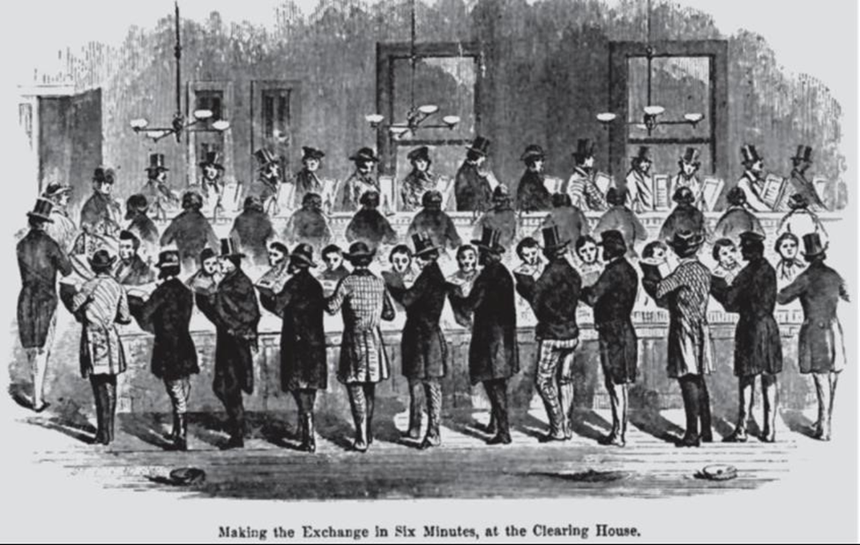
Banks develop Local and Regional Clearing
At small scale, the banker/bookkeeper easily provides validation, clearing and settlement of transactions for the market transactions of clients: a bank is a clearing house – this is Keynes’s bank money system.
As banks multiplied and clients engaged in transaction that required settlement with other banks, systems of local clearing houses were developed in which member banks engaged in net clearing of their client accounts
Alexander Hamilton: ‘Every loan, which a Bank makes is …, a credit given … on its books, the amount of which it stands ready to pay, … But, in a great number of cases, no actual payment is made…. The Borrower frequently … transfers his credit to some other person, to whom he has a payment to make; who, in his turn, is as often content with a similar credit . . …. performing in every stage the office of money, till it is extinguished by a discount with some person, who has a payment to make to the Bank, to an equal or greater amount. Thus large sums are lent and paid, frequently through a variety of hands, without the intervention of a single piece of coin.”

Slide 19
Local to Regional to Resistance to National Clearing
net clearing across client accounts in individual financial institutions led to clearing across multiple banks to resolve the difficulties associated with increasing size through the creation of formal Clearing house associations
In England the process of national clearing was initiated by a 1854 decision to allow settlement via drafts on Bank of England accounts and eventually admitting the Bank to membership of the Clearing in 1864. Metropolitan (London) Clearing was instituted in 1907. But since these systems were private associations, there were always problems of making them fully inclusive. The English identification of a “clearing bank” as an exclusive member lives on despite the fact that the Bank of England eventually became the de facto inclusive national Clearer.
In the United States the proposals for a National Clearing preceded discussion of a Central bank and well before the 1913 creation of the Federal Reserve (indeed some thought it would have made a Central bank redundant).
As in England, members of the New York Clearing house resisted extending membership to competitors; indeed the exclusion of trust banks is credited as a contributing factor in the crisis of 1907 that generated calls for a central bank.

Slide 20
Private National Clearing and Innovation
In the mid-1950s Bank of America developed ERMA (Electronic Recording Machine, Accounting) a computerised system to facilitate and reduce costs of check processing. In the early 1960s, Barclays Bank in England purchased its first mainframe computer and established electronic clearing.
By the mid-1960s, banks in the United States, Britain, and elsewhere would begin exploring the application of computer automation to teller operations, embarking on a technological trajectory that by the 1970s would lead to the Automated Teller Machine. (ATM)
The creator of what was to become Visa approached clearing as money represented by guaranteed alphanumeric data used in shared computer clearing networks. He aimed at a system in which any alphanumeric value—whether a credit account, checking account, savings account, or brokerage money market account—could be used for electronic-based global purchases or transfers.
It was thus the introduction of bank credit cards that led to the replacement of manual clearing and settlement through an automated computer system that eliminated the mailing of paper by transforming the sales drafts into electronic records and clearing through a centralized powerful IBM computer. The NBI/Visa BASE II was America’s first nationwide automated clearinghouse.
By the 1980s electronic money systems, meant to replace physical cash transactions were ubiquitous, and could have been applied to the problems of the checking system and provided a system of national direct clearing. However, despite the support of the European Union -- facing the problem of currency unification in the ECU -- for David Chaum’s digicash, and its introduction by the St Louis bank which had Hy Minsky on its Board of Directors, these digital or electronic money systems never prevailed. Electronic digital money had to wait until the 1990s and the creation of bitcoin based on an accounting procedure called blockchain However, neither bitcoin nor any of the other cryptocurrencies provide for the equivalent of the evasive national Clearing house system.

Slide 21
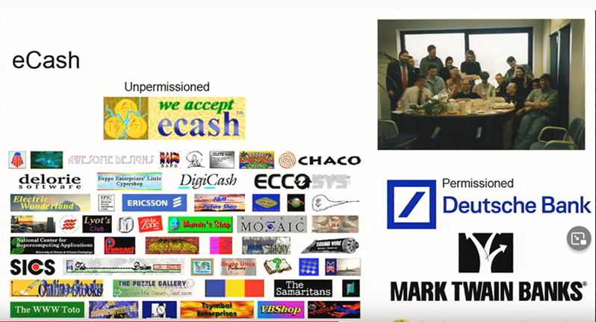
Chaum’s electronic cash: Minsky was a Director of Mark Twain Banks

Slide 22
Clearing Systems are Message Exchanges
Digital Money: Binary representation and Verification
The very first attempt at a secure messaging system that was extended to the creation of a non-commodity money dates from the late 1960s.
Stephen Weisner, a young graduate student grappling with the implications of the Bell theorem proving non-locality in quantum mechanics proposed a perfectly secure “quantum money” which could not be copied or counterfeited.
The serial number expressed on each dollar bank note would carry a set of superpositioned photons inside special boxes. The issuing bank would insert the photons in definite states of polarization and keep a sealed record in its archives of the arrays of polarizations that went with each serial number.
Making a copy of the bill would require making measurements of each photon’s polarization. If a photon in a box had been set in circular polarization, but the counterfeiter chose to measure linear polarization instead, he would have a fifty-fifty chance of finding horizontal or vertical polarization, but not circular. For every unit of quantum currency the counterfeiter would need to know whether each photon was in a linear or circular polarization state before even attempting to make a measurement or produce a copy. The bank, meanwhile, could easily check any bill against its own records to detect fakes.
Simon Singh, The Code Book

Slide 23
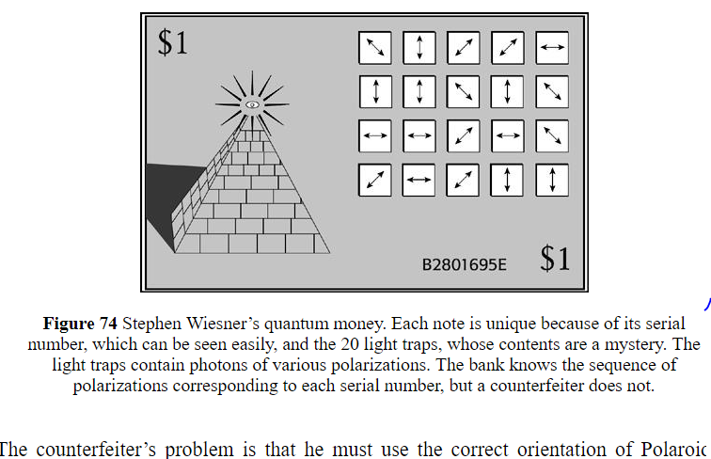

Slide 24
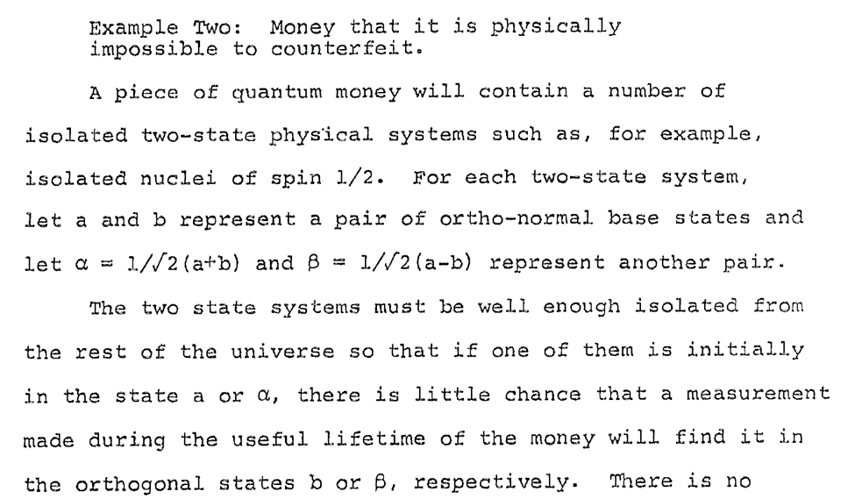
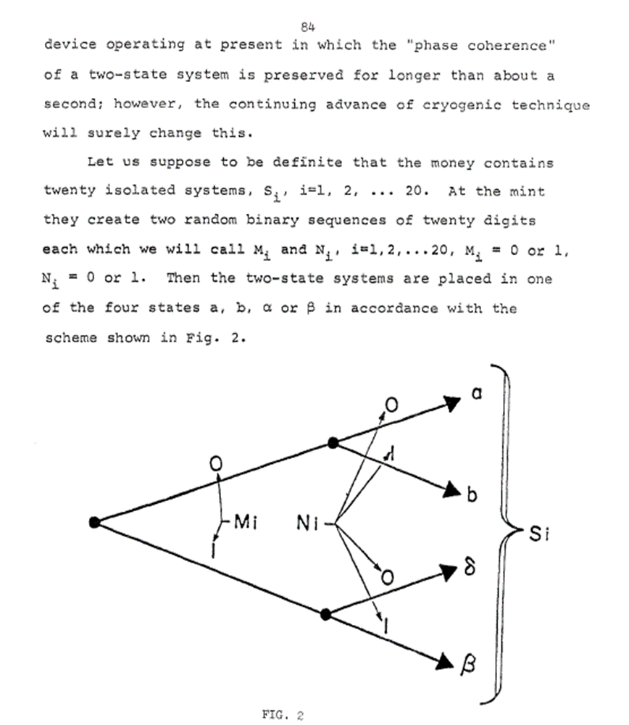
While this approach was exceedingly expensive, there was a positive application made in Vienna in April 2004 in which the city’s mayor and the director of one of the city’s largest banks collaborated with physicists from the University of Vienna and a spin-off company to produce the first electronic bank transfer using quantum cryptography. Specially prepared beams of light transmitted an unbreakable code—an encryption key—between the bank’s branch office and city hall. If anyone else had tried to listen in on the signal, the eavesdropping would have been detected easily and unambiguously.

Slide 25
Modern Digital Technology for a Clearing System
Schumacher’s version of Keynes’s clearing system comes very close to a decentralised autonomous organisation (DAO) since all countries and their national currencies participate in the determination of the operation of the system and the level of imbalances independently of each other. Neither surplus nor deficit countries can dominate the determination of the clearing balances and each countries’ individual actions determines the overall outcome. No particular creditor country can impose policy on any particular deficit country, and each retains national sovereignty in that it can act to influence the system by adjusting domestic policy to reduce their “investment” in the securities of deficit countries.
At the same time, any national central bank is free to introduce its own digital currency (CBDC) in the shape and form it prefers as there will never be any problem of interoperability or exchange since each CBDC remains in the domestic system. There need be no exchange or support of the domestic system since it is not used to finance international transactions. The system at the national and global level could be operated electronically by means of smart contract code on national and a global balance sheet or permissioned central distributed ledger. It would eliminate national currencies as reserve balances in member countries central banks, indeed eliminate the need for capital or reserve balances in commodities or currencies and provide an incentive mechanism to keep global imbalances under control.
It is interesting that while governments have been slow to recognise the advantages of such a system, there is already a private sector equivalent of Schumacher’s proposal which provides a clearing house for virtually all types of financial transaction. See https://finance.yahoo.com/news/webtel-mobi-us-subsidiary-wm-120900804.html.

Slide 26

A functioning private telecommunications sector internet clearing system patterned on Keynes’s clearing proposal already exists

Slide 27
Some Additional Considerations
What Digital currency – this is not crypto,
Will the digital currency system wholesale or retail?
Wholesale CBDC: Digital reserve accounts for Private banks at CB
    We already have digital wholesale system: Fed wire, government securities
  Private banks issue public digital accounts backed by their CBDC accounts
    Do not need blockchain technology to do this – equivalent to 100% banking proposal
Retail : CBDC
  Private clients hold accounts at central banks – automatic domestic clearing
  Central banks link international payments - automatic global netting
  Do we still need central banks?
    If CBDC replace private bank liabilities no need for Central Banks’ prudential regulation and reserving – bank runs no longer exist
    Issue of Digital cash could be done by National Treasury/Finance Ministry
    They all hold clearing accounts with the Clearing Union
Do we have the bandwidth?
Who Decides on the Directed lending of the Investment Pool? COP?

Slide 28
Thank You
        jankregel.org

