Slide 1
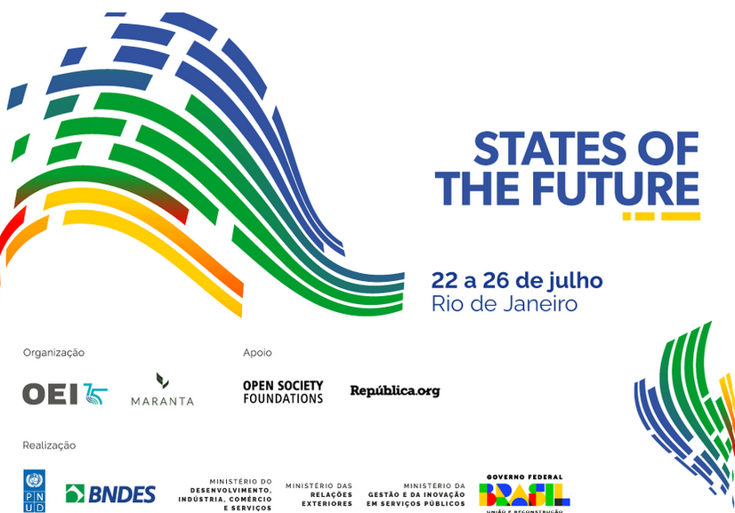
REFORM OF THE INTERNATIONAL FINANCIAL SYSTEM
From Flying Money
to
Spooky Action at a Distance
Who’s Afraid of Keynes’s Clearing Union?
Jan Kregel

Slide 2
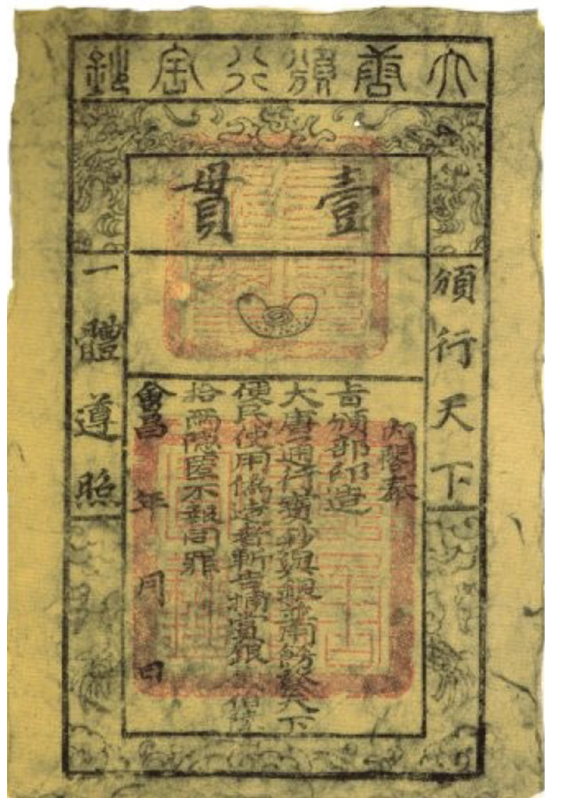
Tang Dynasty (618-907) : fei ch’ien (flying money)
“Non-monetary” transfer systems have existed for some 1,500 years
Fei ch’ien (also known as pien-huan: credit exchange) allowed provincial authorities to present monetary tribute to the imperial court via liaison offices in Chang’an known as chin-tsou yüan, "memorial presenting courts“; merchants with revenues in the north would deposit in exchange for vouchers guaranteeing reimbursement in their provinces while the provincial authorities used the cash deposits for tribute to the Imperial court.
A double transfer of cash was realized without an actual physical transfer.
The development of paper money for transactions in Chengdu is closely related to the development of "flying money“.
Lien-sheng Yang, Money and Credit in China: A Short History, Harvard University Press, 1952 p. 51-2
NB: Imperial China did not deficit finance via issue of public debt, private deposit banking developed very late, despite the early and multiple experiments with paper money, relying on silver until the Ming. Banking remained the equivalent of money transfer offices.

Slide 3
12th century Szechuan Southern Song
kung-chü, "public certificates,"
kuan-tzü, "communicating medium,"
provided a means for the government to send funds to the provinces and for merchants to send funds to the capital.
kuan-tzü or hsien-ch'ien kuan-tzü, "cash communicating medium,“ had already been used in the Northern Song by both government authorities and private individuals similar to the "flying money“.
The Southern Song dynasty used kuan-tzü (1131) to supply military forces.

Slide 4
Medieval Flying Money
1233: Siena bankers acted as fiscal agents for the Pope were authorized to lend to ecclesiastics to meet the donations and grants customary at the time of induction into the various ecclesiastical offices and dignities.
Closely associated with this class of business was the general trade of northern France and Flanders centering in the Trade Fair of Champagne and Flanders. The Italian companies … were deeply involved in the fair trade and seem to have furnished some means for the establishment of a primitive form of interregional clearance.
In the early thirteenth century transactions were cleared by book transfers. A merchant making purchases he could not pay in specie promised payment to his creditor through a money-changer at the close of the fair. While payment was promised in specie, some proportion of the total transactions were doubtless settled by book clearance. This type of transaction was not uncommon in general commercial practice.
Since there was no obligation by the banker to pay until the end of the fair did not involve any loan on the part of the banker. The banker merely guaranteed the debtor payment.

Slide 5
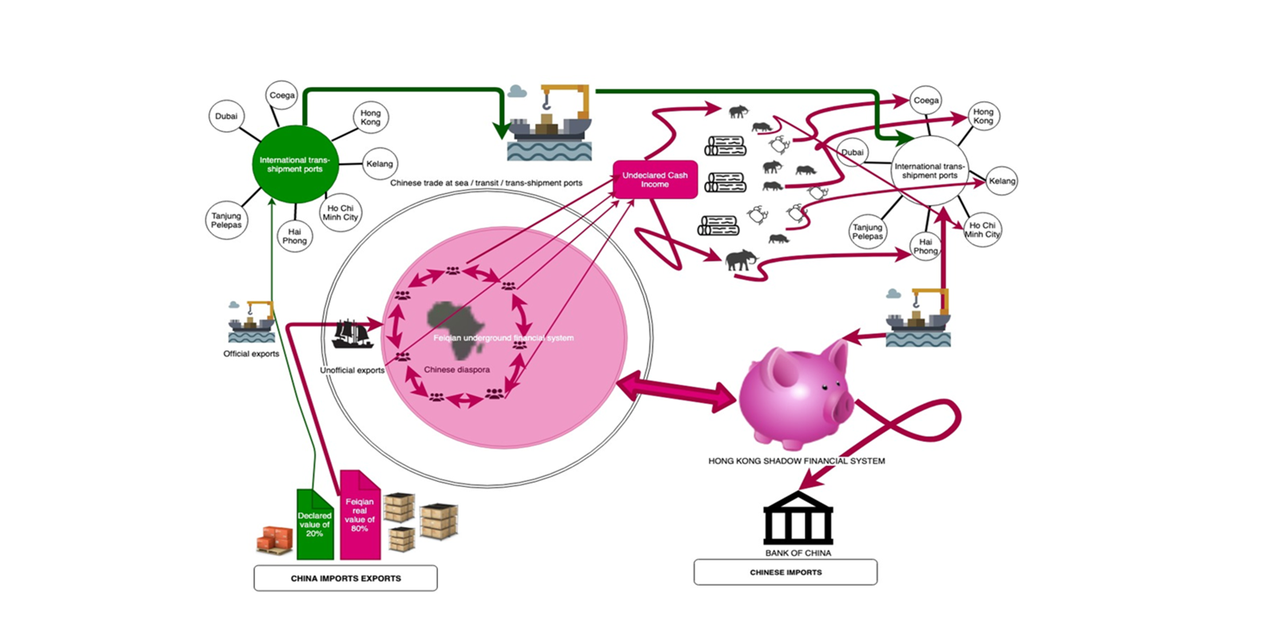
Chinese Flying Money still used today:
the key, enabling financial mechanism deployed by the local poaching and Chinese smuggling syndicates is known as "Chinese Flying Money" or "Fei Qian", an ancient trade-based settlement system by means of which billions of dollars are invisibly exported from Africa to China

Slide 6
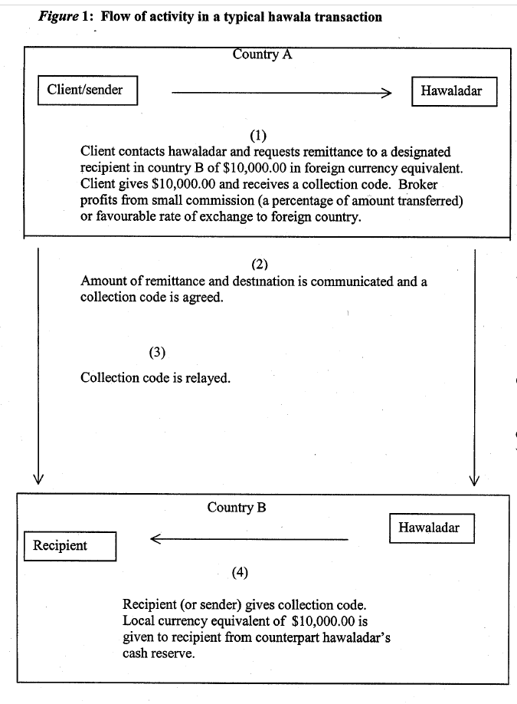
Hawala/Hundi
The terms hawala and hundi are both used to refer to an informal money transfer system: The word hawala comes from the Arabic root h-w-l, which has the basic meanings “change” and “transform”.
Hawala is a bill of exchange or a promissory note. When the word came into Hindi and Urdu, it retained these meanings but also gained the additional meanings “trust” and “reference”, which reflect the manner in which the system operates.
A person who wants to transfer money contacts a local hawaladar and gives them the money to be transferred, along with the name and contact details of the recipient. The hawaladar then contacts a trusted hawaladar in the recipient’s area and arranges for the money to be delivered to them.
The hawaladars involved in the transaction do not actually transfer the money physically. Instead, they record the transaction in their books and settle the balance at a later date through their own networks of hawaladars. This means that the money is effectively transferred without actually moving across borders.
Hawala has been used for centuries, and continues to be popular in many parts of the world for those who do not have access to traditional banking services.

Slide 7
Other alternatives:
Chit system
Wages of British workers deposited to escrow account managed by a Chinese comprador; their food and essentials bought from local merchants were paid by writing debt notes or chits which the merchant presents to the comprador for payment who debits the accounts of the foreign workers
  Company store system used in early US mining: wages created store credit which was debited on purchase of goods
Chop system
Resident of Country A seeking to remit to Country B contacts a “broker” who receives money and enters a credit in a ledger book and forwards the relevant information about the transaction (amount to be remitted, name and location of recipient, etc) and creates evidence of the credit (a train ticket or playing card “chopped” in two) giving one “chop” to the client and sending the other to a counterparty broker in Country B. The client sends his half of the “chop” to the recipient who presents it to the counterparty to match the two halves of the chop and receive the transfer.
Letters of Credit – Bills of Foreign Exchange – Travelers’ Cheques
Leonides Buencamino and Sergei Gorbunov Informal Money Transfer Systems: Opportunities and Challenges for Development Finance ST/ESA/2002/DP/26 DESA Discussion Paper No. 26 November 2002 United Nations

Slide 8
Lived on until the 1980s in postal payment systems
Postal Savings/Payment Systems
All of these flying money systems require telecommunications: transmission of “messages” containing payment information
In most countries postal services provided money transfer systems
  From the Counts of Thurn und Taxis who held the hereditary postal franchise from 1460 to 1867 for the Holy Roman Empire and its successor States to Western Union stage coach and telegraph money transfer services to telephone messages to William Howard Taft introducing in the US,
  government ministries of posts rather Treasury or Central Banks have retained responsibilities of these systems.

Slide 9
Even Economic theorists noticed these clearing systems
Classical Economists:
Petty in the mid-17th century: “Mony is an artificial Thing or rather No Thing … but Is rather ye Sign of a Thing. For If men were excellently Versed in accompts Mony were not necessary at all and many places as Barbados &c have made shift without it & and so they do in Banks.”
Smith (1776): “Buying and selling upon credit, and the different dealers compensating their credits with one another, … will supply {physical money} with less inconveniency” than barter. “
Ricardo (1816): instead of gold being used in exchange “money is merely written off one account and added to another”; so payments may be “effected without the intervention of either bank notes or money.”
NeoClassical Theorists:
Jevons: “a far more potent source of economy is what we may call the Cheque and Clearing System, whereby debts are, not so much paid, as balanced off against each other. The germ of the method is to be found in the ordinary practice of book credit.”
Walras: “the idea of settling a certain number of daily exchanges by means of the following procedure. People who have a credit account at a bank buy and sell commodities all day long to or from each other, just paying by means of receipts on their bank called cheques. Between 5.00 p.m. and 6.00 p.m. the bankers meet and compensate their clients’ debts and credits and each of them supplies in money only the surplus of cheques written over those he received, or obtains in money only the excess of the cheques he received over those he wrote. Purchases and sales are also made by credit,” e.g. “the compensation of cheques between banks, in clearing houses, has as a result that things take place as if all exchangers had the same bank, in the sense that, where a cheque is brought to the credit of one client and at the same time to the debit of another, its handing over does not bring any transfer of money with it;

Slide 10
Einaudi called it “Imaginary money”
But, the absence of a physical representation of decentralized digital money is not as innovative as it may seem. As noted above, from the 12th century for bankers and economists who “were excellently Versed in accompts Mony were not necessary at all ...”
Luigi Einaudi pointed out in a paper published in the 1930s that medieval monetary systems were based on purely notional or “imaginary” units of account that did not reflect any real metal coinage or a “real” or commodity money:
“The imaginary or account money, the libra or livre or lira of old, was … even more abstract than a paper note, an image, or mirror, reflecting money; it was a mere “ratio". The price of a good is, indeed, not a material thing. … it is an abstract ratio. … The device of imaginary or account money came gradually to be adopted all over Europe between the ninth and eighteenth century as a convenient way of stating that the price of merchandise is a ratio between a given quantity of that article of merchandise in a given quantity of another.”
Einaudi, Luigi (1937). “The Medieval Practice of Managed Currency.” In A. D. Gayer (ed.), The Lessons of Monetary Experience. New York: Rinehart.

Slide 11
Schumpeter: Treatise on Money and History of Economic Analysis
“But logically, it is by no means clear that the most useful method is to start from the coin —even if, making a concession to realism, we add inconvertible government paper— in order to proceed to the credit transactions of reality.
It may be more useful to start from them in the first place, to look upon capitalist finance as a clearing system that cancels claims and debt and carries forward the differences—so that ‘money’ payments come in only as a special case without any particularly fundamental importance.” (HEA, 717)
“It is much more realistic to say that the banks ‘create credit,’ that is, that they create deposits in their act of lending, than to say that they lend the deposits that have been entrusted to them.” (HEA, 1114)
“In this method of obtaining a – basically random – unit of account as well as of entitlement, lies, as we shall see, the core of the institution of money of the profit economy,” (ToM: 109)

Slide 12
Keynes: Treatise on Money chapter 1: Bank Money to Banking Principle
”Money-of-Account, namely that in which Debts and Prices and General Purchasing Power are expressed, is the primary concept of a Theory of Money. A money of account comes into existence along with debts, which are contracts for deferred payment, and price lists, which are offers of contracts for sale or purchase. Such debts and price lists, whether they are recorded by word of mouth or by book entry on baked bricks or paper documents, can only be expressed in terms of a money of account. Money itself, namely that by delivery of which debt contracts and price contracts are discharged, and in the shape of which a store of general purchasing power is held, derives its character from its relationship to the money of account, since the debts and prices must first have been expressed in terms of the latter.”
“the introduction of a money of account …leads to “the discovery that for many purposes the acknowledgments of debt are themselves a serviceable substitute for money proper in the settlement of transactions. When acknowledgments of debt are used in this way, we may call them bank money—not forgetting, however, that they are not money proper.
Bank money is simply an acknowledgment of a private debt, expressed in the money of account, which is used by passing from one hand to another, alternatively with money proper, to settle a transaction.” (Ibid. 5)
This bank money of account is liberated from any physical or commodity form and reflects what Luigi Einaudi has called “imaginary money”. Bank money of account serves as money proper when it is the object of action of bankers “entering debits and credits in their clients’ accounts.“ Bankers managing clients’ accounts denominated in money of account thus replace gold or bank notes as the “primary concepts” of monetary theory and substitute for the quantity theory of prices.

Slide 13
From International Currency and Finance to “Notes on Ancient Currency“ to Tract on Monetary Reform to Treatise on Money: Banking Principle
Keynes worked on International Monetary Reform his entire career from Versailles to Bretton Woods
He also worked on an alternative to the Quantity theory of Money from the Tract on Monetary Reform to the General Theory
Can Keynes’s alternative monetary theory based on the netting of bank money settlement in a clearing house – “the banking principle”—be scaled up from the single bank, to the national level and then to the international level to form a global Currency Union,
Who would be responsible for the operation of the global multilateral clearing system in the absence of an international bank or equivalent global institution?

Slide 14
Currency Union is Banking Principle on a global scale
Keynes: “The idea underlying such a Currency Union is simple, namely, to generalise the essential principle of banking, as it is exhibited within any closed system. This principle is the necessary equality of credits and debits, of assets and liabilities. If no credits can be removed outside the clearing system but only transferred within it, the Union itself can never be in difficulties. It can with safety make what advances it wishes to any of its members with the assurance that the proceeds can only be transferred to the clearing account of another member. Its problem is solely to see to it that its members keep the rules and that the advances made to each of them are prudent and advisable for the Union as a whole.” (Horsefield, 3)

Slide 15
Schumacher’s Amendment: Multilateral Pool Clearing
Every country sets up an independent agency called the National Clearing Fund.
Importers make payments in their own national currency into their own National Clearing Fund. As soon as the Fund has received payment, it informs the National Clearing Fund of the exporter that payment has been received, whereupon the National Clearing Fund in the exporter’s country makes payment to the exporter. Each National Clearing Fund thus receives and disburses only national currency: it receives such currency from the home importers
and disburses it to the home exporters.
Over time National Clearing Funds can be divided into three classes:
1. The Clearing Funds of (“deficit countries”) will have received more national currency from importers than they have disbursed to exporters and will consequently be left with a credit balance.
2. The Clearing Funds of (“surplus countries”) will have disbursed more national currency to their exporters than they have received from their importers and will consequently be left with a debit balance.
3. The Clearing Funds of countries in external balance with neither with a balance of cash in hand nor with a debit balance of any kind.
Thus the Clearing Funds of deficit countries would be left with a balance of cash in hand, and since it would be undesirable if the Clearing Funds interfered in internal monetary policy, the proper way to employ this balance would be for them to purchase Treasury bills in the open market; similarly the Clearing Funds of surplus countries would be in need of cash and should raise such cash by selling Treasury bills in the open market. In this way National Clearing Funds would operate in a manner analogous to that of Exchange Equalisation Funds.

Slide 16
In Schumacher’s amendment Bancor (and gold and the $US) disappears
“In this way, one might say, every national currency is made into a world currency, whereby the creation of a new world currency becomes unnecessary. Nor does the International Clearing Office—in this connection—require any special powers; it is not an agency for control, but a purely administrative body, the central accounting office for the different National Clearing Funds. .
.. As a result of its (purely formal) operations, we get the following position: The Clearing Funds of surplus countries become indebted to their internal money markets and acquire an equivalent share in the Pool; both their debt and their share in the Pool being equal to their trade surplus. The Clearing Funds of the deficit countries are left with balances of cash in hand (equal to their trade deficits) which belong to the International Pool. The Clearing Funds, finally, of countries whose balance of trade has left neither surplus nor deficit hold neither cash nor a share in the Pool. ...
The main force is the fact that the holding of surpluses becomes unprofitable and risky. The surplus, instead of being convertible into gold or interest-earning investments, is tied up in the Pool: it is a share in the Pool.” And the Pool’s assets are diversified in the government securities of countries with the weakest currencies. This provides an incentive for surplus countries to take action to spend their balances, automatically improving the risk characteristics of their holdings of the International Clearing Office.
E.F. Schumacher, “Multilateral Clearing,” Economica, New Series. Vol. 10, No. 38, May 1943, 150-165.

Slide 17
Beyond Currency: An International Investment Fund
E. F. Penrose has highlighted additional features of Keynes’s ideas:
“From the beginning, Mr. Keynes … was willing to use the proposed International Clearing Union for short term as well as long-term purposes:
The Union might set up a clearing account in favour of international bodies charged with post-war relief, rehabilitation and reconstruction.
But it could go much further than this. For it might supplement contributions received from other sources by granting overdraft facilities in favour of these bodies, the overdraft being discharged over a period of years out of the Reserve Fund of the Union, or, if necessary, out of a levy on surplus credit balances.
By this means it is possible to avoid asking any country to assume a burdensome commitment for relief and reconstruction, since the resources would be provided in the first instance by those countries having credit clearing accounts for which they have no immediate use and are voluntarily leaving idle,
and in the long run by those countries which have a chronic international surplus for which they have no beneficial employment. (Penrose 1953, 43)

Slide 18
Kalecki/Schumacher Amendment: An International Investment Pool
In an amendment to extend the clearing union to accommodate international capital investment flows (Kalecki and Schumacher, 1943) noted that :
“There is no merit in a general policy aiming at current account equilibrium for all countries, because different countries are at different stages of economic development, and a regular flow of investment from the more highly developed to the more backward regions of the world may redound to the benefit of all. ”
“In order to achieve and maintain a truly international system in the post-war world the International Clearing Union must also assume the function of long-term lending to underdeveloped countries and wield certain additional powers,” such as directed purchase and lending.
The authors go on to recommend that the Board may direct countries to direct their purchases to particular countries to ensure limits on bilateral imbalances, noting that
“If investment decisions have to be taken by an international authority, there arises, of course, a political problem of the first magnitude. The mainly administrative functions to be discharged by the Board of the International Clearing Union are, relatively speaking, politically neutral. But investment decisions, and decisions directing a borrower to make his purchases in one particular country, involve a higher degree of political responsibility.”
An integration of the COP in this process seems obvious.

Slide 19
Modern Digital Technology for a Clearing System
Schumacher’s version of Keynes’s clearing system comes very close to a decentralised autonomous organisation (DAO) since all countries and their national currencies participate in the determination of the operation of the system and the level of imbalances independently of each other. Neither surplus nor deficit countries can dominate the determination of the clearing balances and each countries’ individual actions determines the overall outcome. No particular creditor country can impose policy on any particular deficit country, and each retains national sovereignty in that it can act to influence the system by adjusting domestic policy to reduce their “investment” in the securities of deficit countries.
At the same time, any national central bank is free to introduce its own digital currency (CBDC) in the shape and form it prefers as there will never be any problem of interoperability or exchange since each CBDC remains in the domestic system. There need be no exchange or support of the domestic system since it is not used to finance international transactions. The system at the national and global level could be operated electronically by means of smart contract code on national and a global balance sheet or permissioned central distributed ledger. It would eliminate national currencies as reserve balances in member countries central banks, indeed eliminate the need for capital or reserve balances in commodities or currencies and provide an incentive mechanism to keep global imbalances under control.

Slide 20
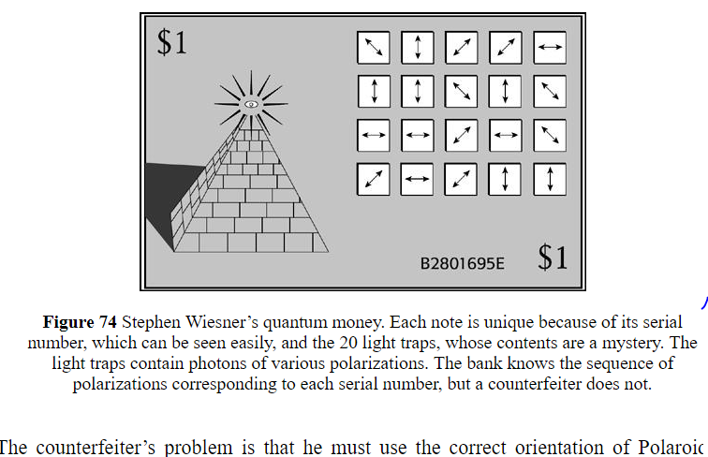
Pre Internet Quantum Cash

Slide 21
The Pre-Internet Quantum Cash
The very first attempt at a secure messaging system that was extended to the creation of a non-commodity money dates from the late 1960s.
Stephen Weisner, a young graduate student grappling with the implications of the Bell theorem proving non-locality in quantum mechanics proposed a perfectly secure “quantum money” which could not be copied or counterfeited.
The serial number expressed on each dollar bank note would carry a set of superpositioned photons inside special boxes. The issuing bank would insert the photons in definite states of polarization and keep a sealed record in its archives of the arrays of polarizations that went with each serial number.
Making a copy of the bill would require making measurements of each photon’s polarization. If a photon in a box had been set in circular polarization, but the counterfeiter chose to measure linear polarization instead, he would have a fifty-fifty chance of finding horizontal or vertical polarization, but not circular. For every unit of quantum currency the counterfeiter would need to know whether each photon was in a linear or circular polarization state before even attempting to make a measurement or produce a copy. The bank, meanwhile, could easily check any bill against its own records to detect fakes.
Simon Singh The Code Book

Slide 22
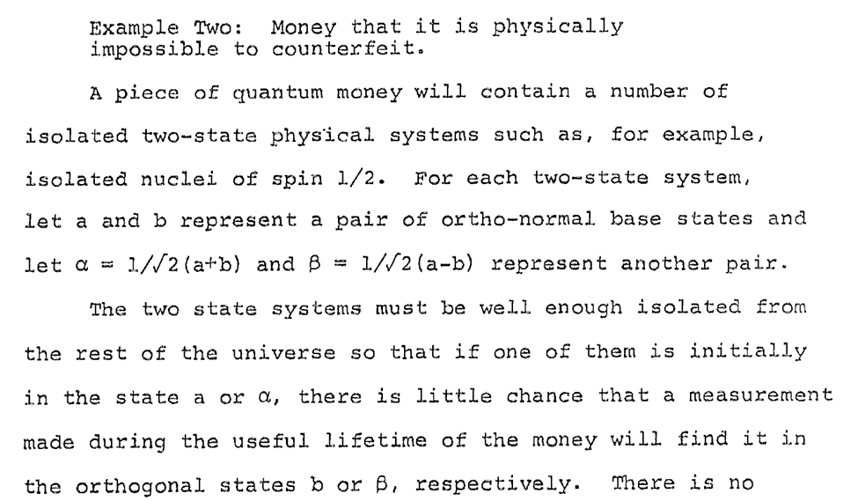
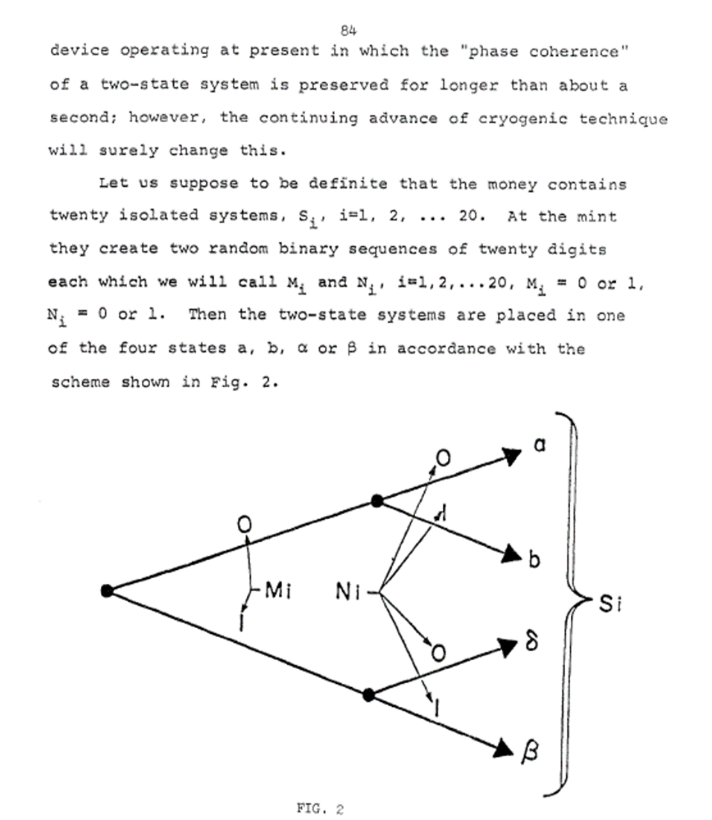
While this approach was exceedingly expensive, there was a positive application made in Vienna in April 2004 in which the city’s mayor and the director of one of the city’s largest banks collaborated with physicists from the University of Vienna and a spin-off company to produce the first electronic bank transfer using quantum cryptography. Specially prepared beams of light transmitted an unbreakable code—an encryption key—between the bank’s branch office and city hall. If anyone else had tried to listen in on the signal, the eavesdropping would have been detected easily and unambiguously.

Slide 23
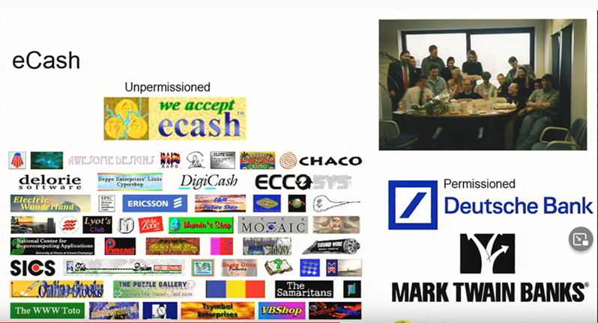
Chaum’s ecash: Minsky was a Director of Mark Twain Banks

Slide 24

A functioning private telecommunications sector internet clearing system patterned on Keynes’s clearing proposal already exists
https://finance.yahoo.com/news/webtel-mobi-us-subsidiary-wm-120900804.html.

Slide 25
Some Additional Considerations:
What Digital currency – this is not crypto,
Will the digital currency system wholesale or retail?
Wholesale CBDC: Digital reserve accounts for Private banks at CB
    We already have digital wholesale system: Fed wire, government securities
  Private banks issue public digital accounts backed by their CBDC accounts
    Do not need blockchain technology to do this – equivalent to 100% banking proposal
Retail : CBDC
  Private clients hold accounts at central banks – automatic domestic clearing
  Central banks link international payments - automatic global netting
  Do we still need central banks?
    If CBDC replace private bank liabilities no need for Central Banks’ prudential regulation and reserving – bank runs no longer exist
    Issue of Digital cash could be done by National Treasury/Finance Ministry
    They all hold clearing accounts with the Clearing Union
Do we have the bandwidth?
Who Decides on the Directed lending of the Investment Pool? COP?

Slide 26

Thank You
        jankregel.org

