Slide 1

Financing for Development: Theory and Policy
Jan Kregel

Slide 2
Economic Development & Alternatives Sources of Finance: History
Classical Economists — Political Economy
How to generate "Development"
Antonio Serra — What ails Naples? Manufacturing
Smith— What causes the Wealth of Nations
  productivity, population growth
  Specialisation (division of labour)
      This is really organization of production not technical advance
Ricardo — how to increase growth rate
  Reduce agricultural rents to increase profits directed to investment
Marx — Where do profits come from? Labour exploitation
  Cyclical collapse
  Inevitable shift to Social then Communal ownership and production

Slide 3
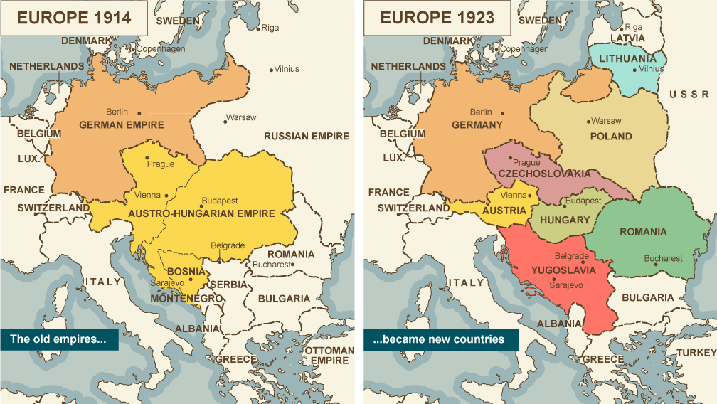
Modern Development Economics stems from Rosenstein-Rodan’s early interest in complementarity and the hierarchy of wants led to concern with the problem of how to create self-sustaining economic systems from the divided remnants of the dissolved Empires

Slide 4
“The end of the First World War delivered the first blow to the world of empires.
The Austro-Hungarian Empire, which once sprawled across most of Eastern Europe, was reduced to a wisp of its former self.
                Austria was one-quarter of its former size and contained one-fifth of its former population.
Hungary lost two-thirds of its territory and two-fifths of its population.
The Ottoman Empire, which had endured over six centuries …contracted to the peninsula of Turkey, with a footprint across the Bosporus.
French and British authorities took over Ottoman territories, including Syria, Iraq, and Palestine, and claimed, at least on paper, to prepare them for self-government.
Germany’s African and South Pacific colonies were divvied up among the victors (with South Africa co-opting Southwest Africa for itself).
These former colonies were now called mandates, with independence deferred to a future date.
Although the League of Nations began its life as a “league of empires,” it grew to offer a space for new claims from the global margins.
… one could see on the map of Eastern Europe, and hear in the speeches of Woodrow Wilson, V. I. Lenin, and anticolonial intellectuals such as Nehru and Mao that a new principle of national self-determination was going global, readying an ambush against the old language of empire.”

Slide 5
From the neo-liberal perspective, three factors empowered the domain of politics against that of the economy after the war.
First, popular sovereignty was strengthened by the generalization of universal male suffrage in Europe and North America, making it more difficult to maintain the gold standard through domestic adjustments borne by ordinary people.
Second, the war left a legacy of what liberals saw as misguided confidence in the power of governments to allocate resources. Since the war, an economy directed by central authorities looked like a viable alternative.
Third, the resolution of the war in the peace treaties of Versailles and St. Germain validated the idea that the nation was the most important category for organizing human affairs.
To the group that would become the neoliberals, the era after Versailles was marked by an attempt to reestablish what they saw as the correct balance between the public world of government and the private world of property and contract.
Concretely, this translated into a series of projects of capitalist internationalism.
There needed to be a respect for private property that trumped national law.
Investment must be able to cross borders back and forth without fear of obstacles or expropriation.
Capital needed to become cosmopolitan again.

Slide 6
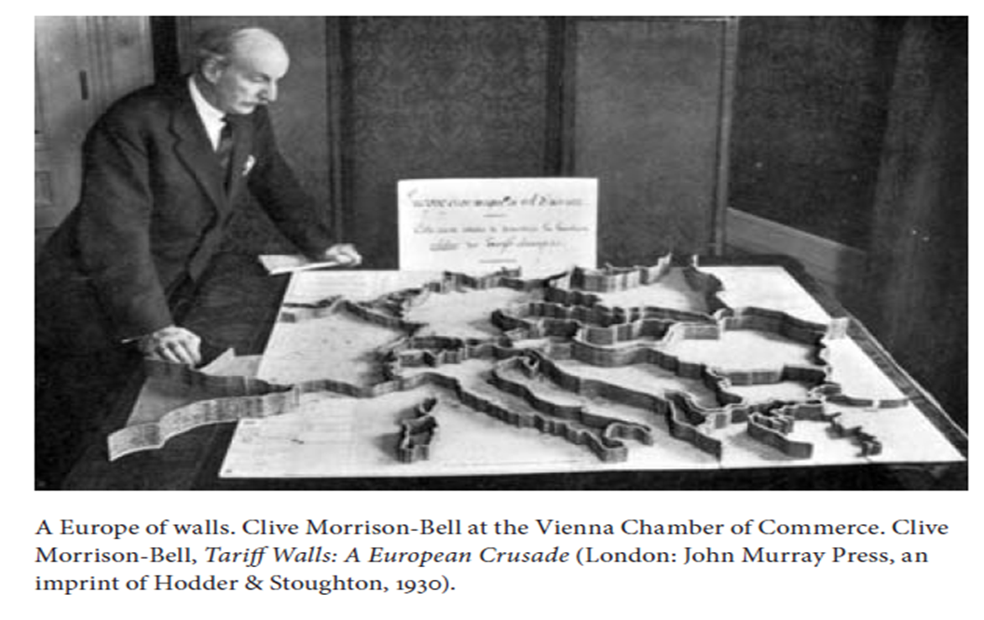
Restore Free Trade – Tariff Walls

Slide 7
Mises Recommendations for Austria
Open to the world market,
make the internal adjustments necessary to compete internationally.
This required two key measures:
  push down wages,
  cut taxes on industry.
…a small country like Austria had no capacity to be self-sufficient.
Treaty of Saint Germain (lost 60% of its territory) had reduced Austria to a population of just over six million people to reliance on the foreign market for raw materials.
.. the end of Austria’s empire meant an increased reliance on access to an open world economy.
Eliminate restrictions on imports and exports,
privatize public enterprises,
eliminate food subsidies,
and, consistent with his belief in free movement, lift entry and residence restrictions for foreigner workers.

Slide 8
Birth of Neo Liberalism
Nascent neoliberals saw the policy of the British Empire as the essence of the success of globalization from 1870 to 1914.
The collapse of the system started in 1931 as democratic pressures of organized labor Keynesianism led to the development of about what a new organizing principle and an organizing force after free-trade and empire under the indirect rule of the City of London.
How to restore the conditions of empire that had supported the separation between imperium and dominium in conditions of democratic national sovereignty?

Slide 9
Keynes things the same way!
Europe was so organized socially and economically as to secure the maximum accumulation of capital. While there was some continuous improvement in the daily conditions of life of the mass of the population, Society was so framed as to throw a great part of the increased income into the control of the class least likely to consume it. The new rich of the nineteenth century were not brought up to large expenditures, and preferred the power which investment gave them to the pleasures of immediate consumption.
In fact, it was precisely the inequality of the distribution of wealth which made possible those vast accumulations of fixed wealth and of capital improvements which distinguished that age from all others. Herein lay, in fact, the main justification of the Capitalist System. If the rich had spent their new wealth on their own enjoyments, the world would long ago have found such a régime intolerable. But like bees they saved and accumulated, not less to the advantage of the whole community because they themselves held narrower ends in prospect.
The immense accumulations of fixed capital which, to the great benefit of mankind, were built up during the half century before the war, could never have come about in a Society where wealth was divided equitably. The railways of the world, which that age built as a monument to posterity, were, not less than the Pyramids of Egypt, the work of labor which was not free to consume in immediate enjoyment the full equivalent of its efforts.
Thus this remarkable system depended for its growth on a double bluff or deception. On the one hand the laboring classes accepted from ignorance or powerlessness, or were compelled, persuaded, or cajoled by custom, convention, authority, and the well-established order of Society into accepting, a situation in which they could call their own very little of the cake that they and Nature and the capitalists were co-operating to produce. And on the other hand the capitalist classes were allowed to call the best part of the cake theirs and were theoretically free to consume it, on the tacit underlying condition that they consumed very little of it in practice. The duty of “saving” became nine-tenths of virtue and the growth of the cake the object of true religion. … And so the cake increased; but to what end was not clearly contemplated. … the virtue of the cake was that it was never to be consumed, neither by you nor by your children after you.

Slide 10
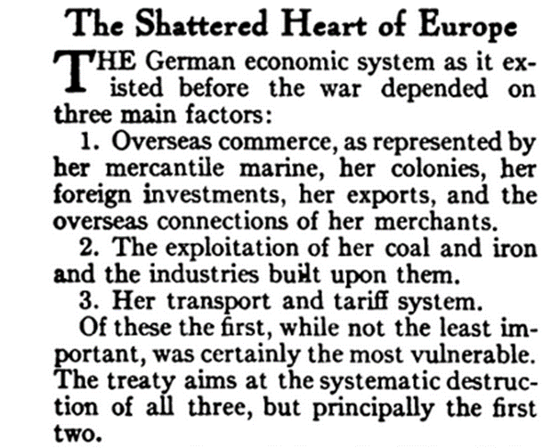
German Economic Decomposition
The interference of frontiers and of tariffs was reduced to a minimum, and not far short of three hundred millions of people lived within the three Empires of Russia, Germany, and Austria-Hungary. The various currencies, which were all maintained on a stable basis in relation to gold and to one another, facilitated the easy flow of capital and of trade to an extent the full value of which we only realize now, when we are deprived of its advantages. Over this great area there was an almost absolute security of property and of person.
These factors of order, security, and uniformity, which Europe had never before enjoyed over so wide and populous a territory or for so long a period, prepared the way for the organization of that vast mechanism of transport, coal distribution, and foreign trade which made possible an industrial order of life in the dense urban centers of new population.

Slide 11

From the League of Nations to the Bretton Woods/WTO system the Neoliberal view prevailed –the Global Imperium that superseded National Soverignty to Preserve Dominium
From “Democratic” Rule of Law to Human Rights it was the “market” that dictated domestic economic policy
Supported by Neoliberal civil servants

Slide 12
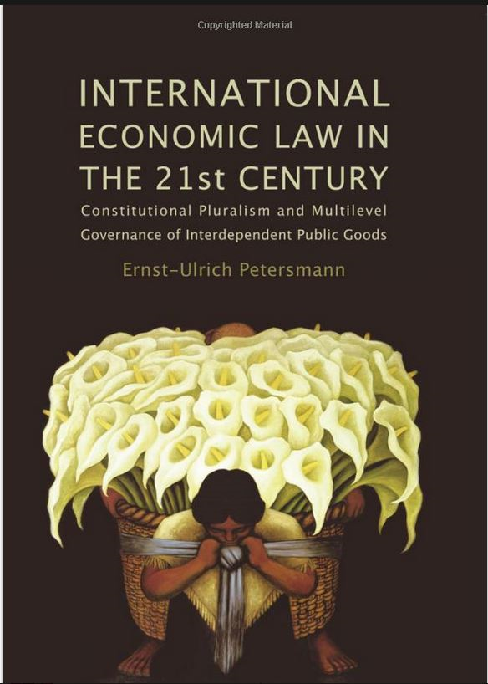
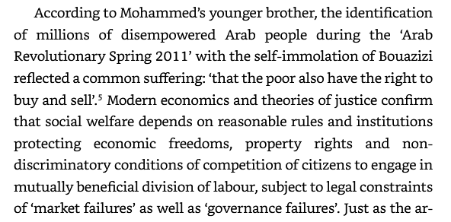
Human Rights and Property Rights
…freedom to sell in the market place as pictured by Diego Rivera on the book cover) may trigger and justify a human rights revolution against welfare reducing economic and political repression.

Slide 13
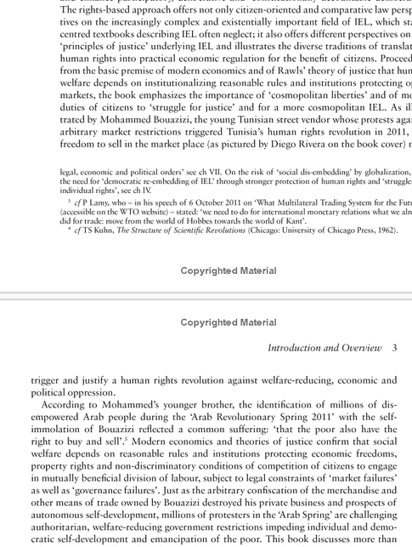

Slide 14
Theoretical Support for Free Capital Movements
“The basic argument for international investment of capital is that under normal conditions it results in the movement of capital from countries in which its marginal value productivity is low to countries in which its marginal value productivity is high and that it thus tends toward an equalization of marginal value productivity of capital throughout the world and consequently toward a maximum contribution of the world’s capital resources to world production and income.”
  Jacob Viner, “International Finance in the postwar World,” Journal of Political Economy, 55, April, 1947, p. 98.

Slide 15
The (Implicit) Stability Constraint and Inequality
Financial Stability – Validating Credits – Paying up on Debts (Keynes: Equilibrium is Blither)
  The Two Masters of Regulation
  Prudential regulation – Defends creditors
  Crisis Bailouts – Defends Financial Institutions
Official Post-War Development Strategy: Finance Flows from Developed to Developing Countries
  ODA financing of developing countries (UN 1% of Developed country GDP target)
  International Capital Market Financing of developing countries (rate of return differentials)
  Meade: “Keynes … gave us by way of a digression a marvelous proof of the fact that international investment always has been and always should be defaulted.”
  Keynes: “It is obvious that no country can go on for ever covering by new lending a chronic surplus on current account without eventually forcing a default from the other parties.”
  Cambridge Capital Controversies – (and Nurkse, Myrdal, etc) no return differential
International Financial Stability: Bretton Woods Stable Exchange Rates
    Balanced External Accounts
    Incompatible with Financial Flows from Developed to Developing countries
    Stable Rates Incompatible with building Manufacturing – Diamand-Kaldor-Prebisch-Myrdal Terms of Trade
    International Imbalances – Natural result of international Development – viz Flying Geese!
What System would be More Appropriate? Keynes Clearing Union (of course)
Notes:
Reported in “James Meade: The Law Mission” in The Wartime Diaries of Lionel Robbins and James Meade, 1943-45, edited by Susan Howson and Donald Moggridge, New York: St. Martin’s Press, 1991, p. 97.
Keynes, “The Balance of Payments of the United States,” Economic Journal, Vol. 56, No. 222 (Jun., 1946), pp. 172-187.

Slide 16
The “Institutional” Constraint:
BW International Financial Stability
Bretton Woods designed to produce stable exchange rates
This was only possible if Current Accounts balanced over time across member states
The Adjustment mechanism: Impose an External Constraint
  Contractionary fiscal policies, reinforced by exchange depreciation if recession not sufficient
But, official development policy was based on large and sustained capital inflows to developing countries to finance sustained external deficits
But if deficits too large, adjustment required reducing growth and development
35

Slide 17
External Adjustment and External Debt
That the visions of the post war financial system and development financing were inconsistent does not appear to have occurred to either the IMF nor the IBRD and the UN, responsible respectively for exchange rate stability and economic development.
Prebisch’s centre-periphery concerns can be seen as a recognition of this inconsistency
The emergence of the Washington Consensus can be seen as a resolution of this cognitive dissonance in official policy by rejecting the need for any special conditions and policies for developing countries.
This internal inconsistency masked another major problem for developing countries: the impact of international debt on external balances.
Over time capital flows generate debt service flows that increase the factor services balances and aggravate current account imbalances, which is incompatible with the stability of the international system conceived at Bretton Woods.
36

Slide 18
The Alternative “Development” Economics
After World War I: Rosenstein Rodan
  How will the newly created economic and political units of SE Europe become self-sustaining
  Based on applied “micro theory”:
    Complementarity
    Externalities
After World War II: Development “Pioneers”
  Former colonies become independent states and lost colonial integration in Empire
UN Trusteeship Council to foster political independence of undeveloped economies
UN recognized need for economic support
9

Slide 19
Rosenstein-Rodan began …with studies on the frontiers of the Austrian theory of consumer demand -- the concepts of complementarity in consumption and production, the time sequence of economic adjustments, and economies of scale.
“The seeds of my development analysis had been planted earlier …in the themes of complementarity and of the hierarchical structure of wants, together with the role of time-that is, the choice of an economic period over which an individual allocates his scarce resources.'
The dynamics of wants and their interrelatedness were much more important to me than the neoclassical attempt at precise characterization of the properties of the utility function. Consumption complementarities, the role of time, the pursuit curve, plus external economies-all these dynamic factors were not to be considered as a second order of smalls, but even more as pervasive in a less developed country.
Not traditional static equilibrium theory but an analysis of the disequilibrium growth process is what is essential for understanding economic development problems.”

Slide 20
My thinking during the 1940s and 1950s led to the theory of the "big push." "There is a minimum level of resources that must be devoted to . .. a development program if it is to have any chance for success.”
Complementarity in production and consumption requires initiating a broad spread of activities in different sectors – or a Big Push
“This theory of the big push contradicts the conclusions of traditional static equilibrium theory in three respects. First, it is based on a set of more realistic assumptions of certain indivisibilities and nonappropriabilities in the production functions. These give rise to increasing returns and to technological external economies.
Second, the theory is meant to deal with the path to equilibrium. At a point of static equilibrium net investment iis zero. The theory of growth must be very largely a theory of investment.
Third, in addition to the risk phenomena and imperfections characterizing investment, the markets in underdeveloped countries are even more imperfect than in developed countries. The price mechanism in such imperfect markets cannot therefore be relied upon to provide the signals that guide a perfectly competitive economy toward an optimum position.
Underlying the need for a big push is the pervasiveness of rural underdevelopment-excess agrarian population. Given that mass migration and resettlement are not feasible, I stated that "The movement of machinery and capital towards labor, instead of moving labor towards capital, is the process of industrialization which, together with agrarian improvement, is the most important aspect of the economic development of the depressed areas."
Industrialization has to be promoted not because of terms of trade, but because external economies are greater in industry than in agriculture alone. Rejecting a strategy of self-sufficiency or an inward-looking strategy of industrialization, I argued for industrialization with the help of international investment and for a pattern of industrialization that would preserve the advantages of an international division of labor and would therefore, in the end, produce more wealth for everybody.”

Slide 21
Rosenstein Rodan: Financial Institutions to Capture Externalities
Eastern European Industrial Trust to finance the capital investment of the required training of labour and the creation of interdependent industries.
Transfer labour from agriculture to a trust of complementary industries which can be financed by the regional governments and the private market.

Slide 22
Keynes’ General Theory explained the source of profits to justify the investments
Keynes was about level of utilization of already existing productive capacity
Cyclical variations in capacity utilization
More Demand: More Output
  Domar problem: More Investment more unused capacity – it is a long-term problem
But Developing Countries
  do not have excess productive capacity
  Mono-commodity producers – terms of trade
  Primarily peasant Agricultural
VKRV Rao: Keynes’s multiplier not applicable to peasant economies
Joan Robinson’s Disguised Unemployment provides the Key to a Keynesian Approach to Development
Becomes the W. Arthur Lewis” “classical” theory based on
Unlimited Supplies of Labour
8

Slide 23
From Disguised Unemployment to Economic Development Theory
Robinson: 1936
“How can we account for the fact that, over the whole range of human history, unemployment in the modern sense is, comparatively speaking, a rare and local phenomenon? The answer is to be found in the existence of disguised un-employment. In a society in which there is no regular system of unemployment benefit, and in which poor relief is either non-existent or " less eligible " than almost any alternative short of suicide, a man who is thrown out of work must scratch up a living somehow or other by means of his own efforts.
Thus a decline in demand for the product of the general run of industries leads to a diversion of labour from occupations in which productivity is higher to others where it is lower. The cause of this diversion, a decline in effective demand, is exactly the same as the cause of unemployment in the ordinary sense, and it is natural to describe the adoption of inferior occupations by dismissed workers as disguised unemployment.”
Thus we may say that unemployment is present when an increase in the output of capital goods (not offset by an increase in thriftiness) would lead to an increase in the output of consumption goods. Let us apply this criterion to disguised unemployment. If a revival of investment were to occur, dismissed workers would be called back from the hedgerows and the street-curbs into their normal occupations.
The analysis of disguised unemployment makes it clear that while everyone is occupied for twenty-four hours a day, so that the total amount of occupation can never be increased, yet employment can be said to increase when part of a man's time is transferred from an occupation in which its productivity is lower to one where it is higher.

Slide 25
From Disguised Unemployment to Development with Unlimited Supplies of Labour
Fully Employing the Domestic Population is the Main Problem of Development
How to you expand income per head if the whole population is employed in agriculture and there is technical progress in agriculture?
  You have the equivalent of disguised unemployment
For Neoclassical theory this became “negative marginal product of labour”
  You can transfer labour out of agriculture without reducing consumption per head
The obvious answer is manufacturing
Wages and Technical progress are higher in manufacturing
The answer to the Employment problem (and the main Development problem) is then transferring disguised unemployed labour into higher productivity occupations
  This requires building a manufacturing sector
  This requires demand for manufactured goods
This is the basis of all Demand-led Development Theories developed from Keynes

Slide 26
Big Push sought external financing
Constraints on Developing Countries:
  Deficient Domestic Savings
  Scarcity of Domestic Resources
  Deficient Capacity to Produce Capital Goods
How to Overcome constraints:
  Increase Domestic Savings
  External Financing for Development
    Bilateral Grants and Concessional lending – ODA
    Multilateral Institutions – IBRD – IDA - IFC
    Private direct investment flows –FDI
    Emigrant Remittances

Slide 27
And Official Development Policy based on Mainstream Approach
First United Nations Development Decade-1961
  Kennedy -- Alliance for Progress
  Objective: 5 per cent GDP Growth
  Instrument: One per cent of developed country GDP to be transferred to developing countries
  Assumption: 0.3 per cent private flows, 0.7 per cent ODA
Growth Rate Target Achieved
Official Aid Target Not (Never) Achieved

Slide 28
Post-war Circular Flow Keynesians Missed
Debt Financial Stock- Flow Interactions
Y = C + I (centrality of Private Sector Balances)
Y = C + I + [G-T] (implies Govt has constraint)
Y = C + I + [G-T] + [X-M] (BWoods fixed X-rate)
  I, G, T, X All Exogenous; M = m(Y)
BWoods Presumption: No Private Capital Flows
Gold Standard Adjustment imposed by IMF
Post Smithsonian: Private Capital Flows
XB = [X - M] - [Net Capital Flows]
Impact on Size of International Imbalances
Only limited by private sector foreign borrowing
Capital Reversals – Financial Crisis

Slide 29
From Current Account (Exchange Rate) Crisis to Capital Account Crisis after BW
1970s Southern Cone Crisis (Chile)
1980s Latin American Debt Crisis (Mexico + LA)
1996 Tequila Crisis (Mexico)
1997 Asian Crisis: Capital Account vs Current Account Crisis
  Post Washington Consensus Crises –
  Trade and Development Report 1997
1998 Russia + LTCM
1999 Brazilian Crisis
2000-2001 Argentine Crisis
AND THEN: Lehman- Greece-Argentina (again?)

Slide 30
Private Flows and International Financial Fragility
Post BW: countries could avoid limits on external imbalances
  Avoid IMF programmes by Borrowing from Private Lenders
  Confusion between Gross Reserves and Net Unborrowed Reserves
  Procyclical FDI Flows
  Real Exchange Rate Volatility
Hedge to Speculative to Ponzi
  Private Borrowing to Meet Interest on Accumulating Private Foreign Debt
Capital Reversals – Reserves Disappear – Capital Account Crisis
Short-term Expansionary/Inflationary Bias
But Long-Term decline
Increased Volatility in Real and Financial Variables
Financial Crisis replaces IMF in restoring hedge Financing profile
  CA surplus (net transfers) by cutting imports more than exports fall

Slide 31

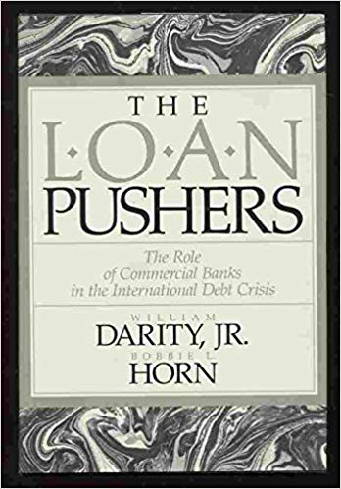
Drivers of Private Capital Inflows
Excess Liquidity Creation in Developed Financial Systems drives capital flows to Developing Countries:
  Michael Pettis: The Volatility Machine
It is Push not Pull (Sandy Darity & Bobbie Horn: The Loan Pushers)
Reach for Yield
Interest Rate Differentials – Carry Trade
Not attraction of the real performance of developing countries or the real returns to be earned on investing in them

Slide 32
Implicit Assumptions Neoliberal Approach
Assumptions
  Diminishing returns to capital investment
    Capital Scarcity in Developing Countries so rate of return in higher
    Capital Surplus in Developed Countries so rate of return in lower
    Aging Developed vs Young Developing Country demographics
Conclusions
  Global investors raise their returns by investing in Developing Countries
  Developing Countries develop more rapidly by Borrowing Capital from Developed Countries
  Global rate of Growth and Wealth Formation Maximised
  Provides Pensions for Old Developed Country Codgers
Notes:
None of these are true

Slide 33
Cambridge Capital Theory Debate:
(Remember that?)
There is ZERO, NADA, NO Theoretical Support for the Assumptions
  Impossible to establish an inverse relation between capital scarcity and rate of return
  Not even possible to measure capital productivity and thus scarcity
Notes:
None of these are true

Slide 34
Assumptions Cannot Be Supported by the Stylised Facts
No empirical evidence that foreign capital inflows increase domestic investment and growth
FDI does not raise rate of investment
Foreign inflows tend to raise domestic consumption and imports
Relative returns will depend on stable exchange rates
Notes:
None of these are true

Slide 35
The Historical Evidence
Negative net transfers have been the rule:
Capital Flows from Developing to Developed Countries
  Post-War 1950s
  Alliance for Progress (AfP) –1960’s,
  Latin America’s “lost decade” of the 1980’s,
  Mexican, Asian financial crises of the 1990’s
  Excess Reserve accumulations of the 2000’s
Private Flows dominate Official Assistance
  Private flows not subject to development needs of recipient countries, but determined by investors’ profit incentives

Slide 36
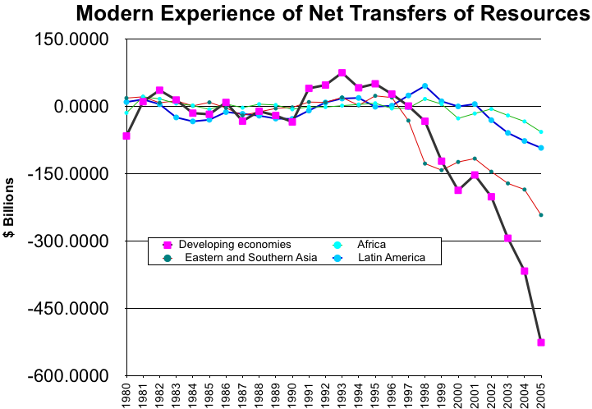

Slide 37
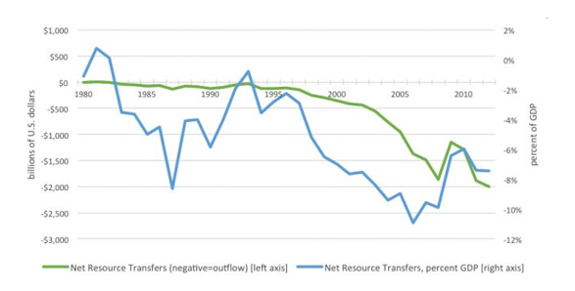

Slide 38
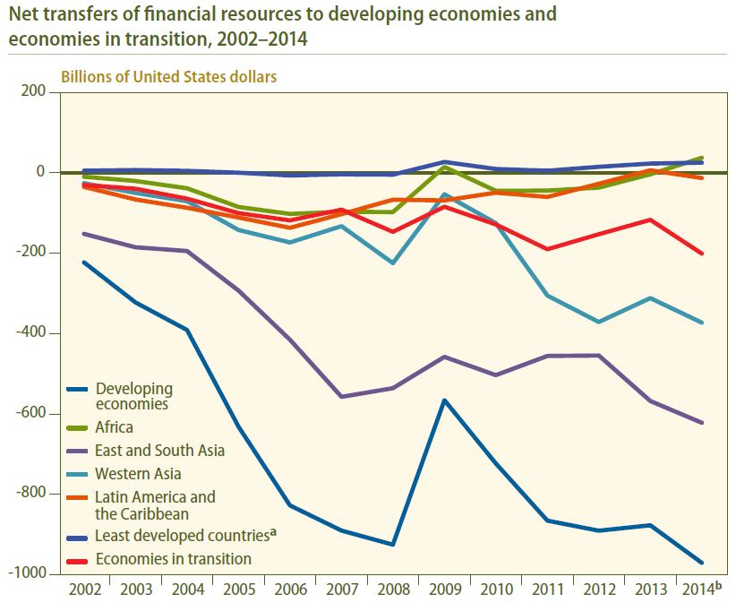

Slide 39
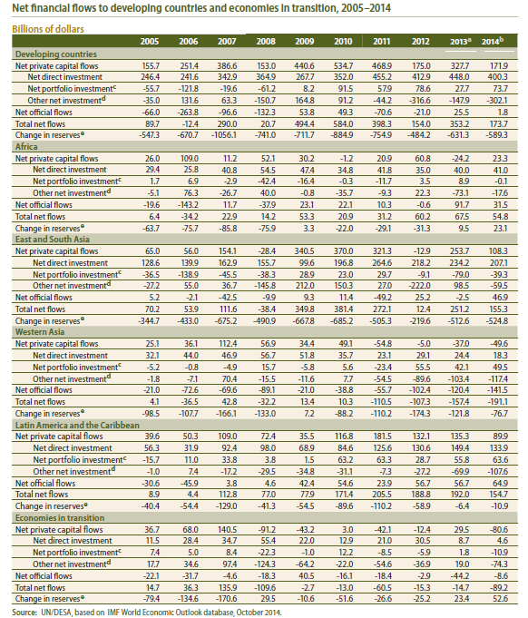

Slide 40
Modern Net Flow Revisionists
Real Growth Theorists
  Increasing returns to investment in
    Human capital
    Market institutions
  Investment in Developed countries may thus have higher returns than investment in Developing countries
  Global Financial Markets may thus may be acting efficiently by creating negative net resource flows
Just Rediscovery of the position of the “Development Pioneers”
  Nicholas Kaldor
  Ragnar Nurkse
  Gunnar Myrdal
  Hans Singer
  Celso Furtado

Slide 41
Modern Equivalent: Build Financial Institutions
“The case for capital account liberalization is a case for capital seeking the highest productivity investments. We have seen in recent months in Asia -- as at many points in the past in other countries -- the danger of opening up the capital account when incentives are distorted and domestic regulation and supervision is inadequate. … The right response to these experiences is much less to slow the pace of capital account liberalization than to accelerate the pace of creating an environment in which capital will flow to its highest return use. And one of the best ways to accelerate the process of developing such a system is to open up to foreign financial service providers, and all the competition, capital and expertise which they bring with them.”*
See what a good job they did with the US Mortgage Market
*Summers, Lawrence (1998) US Government Press Release, 2286, March 9, 1998: “Deputy Secretary Summers Remarks Before The International Monetary Fund.”

Slide 42
And External Financial Flows Generate excess Financial Instability
Minsky Financial Instability Hypothesis: Primarily applied to domestic economy
  Identify cash inflows/outflows
  Analyse Balance Sheets; Income statements
    business firms, households, financial institutions
  Identify Cushions of Safety, Financial Layering
FIH can be applied to International level?
  Imports and exports generate cash commitments and receipts
  International Borrowing and Lending generate cash commitments and receipts; create debt stocks
  Cushions of Safety: Asset sales, Forex Reserves, Net export potential, IMF gold tranche
Detonators of Systemic Financial Instability
  Changes in export demand, export prices, exchange rates, capital flows, interest rates and differentials

Slide 43
Minsky’s Analysis of International Financial flows
“Every liability of a firm, household, government or financial institution, and every instrument traded in a financial market, must be supported by cash flows. These cash flows are derived from participation in productive activity that generates wages, profits, and taxes.
The same requirement that cash flows support asset values holds for international indebtedness, the only difference being that the supporting cash flows may be derived from income denominated in one currency while the payments are denominated in another. … The terms upon which dollars are available for [foreign currency] then determines whether commitments can be fulfilled.
The availability of foreign currency depends upon the balance of payments of the country and the character of the national assets that can be sold or pledged to foreigners.
To examine the problems of availability, it is convenient to divide the balance of payments into tiers that reflect sources and uses of foreign exchange.”
Notes:
Wallenberg Paper

Slide 44
Four Cashflow Generating “Tiers”
Tier 1: Trade (Goods and Services) Balance
Tier 2: Income from Foreign Lending (Factor Service Balance)
Tier 3: Net New Foreign Lending (Long term Capital Account)
Tier 4: Short-term capital movements: Balancing Items
In a 1983 paper delivered at the Centro di Studi Americani in Rome Minsky inverts tiers 1 and 2, arguing that interest and dividends should be considered equivalent to overheads or fixed costs that have to be met before profits resulting from income producing activity on trade account can be booked to available reserves.

Slide 45
FIH Negation of External Financing
Theoretical: How to support the debt created by foreign borrowing to finance development
  DOMAR: A net export surplus can be maintained only if the stock of foreign lending increases at a rate equal or greater than the interest rate charged on the foreign lending
  For a deficit, foreign borrowing must increase at a rate equal or greater than the rate of interest paid on the lending
  If interest rate rises with increasing stocks of foreign loans, then the rate of borrowing must also increase

Slide 46
Domar’s Solution is Ponzi!
The Domar condition is the same as the condition for a successful Ponzi Scheme!
Such schemes are inherently unstable
Thus, Keynes’s recommendation to use capital controls
But long-term stability will require a balanced structure of production that creates exports sufficient to meet debt service
Industrial policy is also necessary for policy space

Slide 47
Debt Financed Growth Undermines Domestic Resource Mobilisation
Both Private flows and Official Aid create debt service obligations
Foreign currency needed for debt service
Foreign currency generated by external surplus
  That is by a negative net resource transfer

Slide 48
Bretton Woods Structural Adjustment Programmes to meet debt service obligations
  Reduce level of activity to free resources to meet debt service
  External surplus is produced via fiscal surplus
  Fiscal surplus created by cutting investment in education, health, social expenditures, government wages
  Fiscal surplus reduces domestic absorption and domestic resource utilisation
  Creates unemployment and lost potential output
  Absence of Social Safety Net creates economics and social marginalisation – informal labour markets
I

Slide 49
The Bretton Woods Constraint:
Bretton Woods designed to produce stable exchange rates
This was only possible if Current Accounts balanced over time across member states
The Adjustment mechanism: Impose an External Constraint
  Contractionary fiscal policies, reinforced by exchange depreciation if recession not sufficient
But, official development policy was based on large and sustained capital inflows to developing countries to finance sustained external deficits
But if deficits too large, adjustment required reducing growth and development
Policy is inconsistent
35

Slide 50
Why IMF Adjustment doesn't Work
Kaldor: in developing countries a “shortfall of exports is generally taken as evidence of over-valuation of the currency. ... it is essential to understand that that it is not the kind of over-valuation that could be ‘cured’ by any uniform adjustment of the exchange rate.”
Since primary commodities form the great bulk of its exports ”the rise in export proceeds in the primary sector which follows a devaluation tends to generate an inflation in domestic costs and prices that soon neutralises any initially beneficial effects on the export costs of manufacturers. ... the rise in the domestic price of export crops is bound, sooner or later, to lead to a corresponding rise in the local prices of food.
And since, at the levels of income characteristic of under-developed countries, money wages in industry will be closely correlated to the price of food, a rise in earnings from primary exports will tend to bring about a corresponding advance in the level of money costs in manufacturing production.” (1964, p. 186-7)
44

Slide 51
IMF exchange rate policy
Kaldor notes, “the periodic efforts of ... the I.M.F. to secure an alleviation of the balance of payments problems of particular under-developed countries by the introduction of more “realistic” exchange rates, ... have proved so misguided.
In most of these cases ... devaluation has been followed by a new wave of inflation which has swallowed up the stimulus to exports afforded by the devaluation, within a relative short period.
The diagnosis that has led to such recommendations has been based on the false analogy from the situation of industrialised countries whose export prices are cost-determined to that of primary producers whose export costs are price-determined.”
45

Slide 52
Exchange rate as a tool of Development
The “Development Pioneers” recognised the conflict between the exchange rate appropriate to support of the export of manufactures and that determined by the exports of the primary sector.
For Prebisch the problem was the creation of manufacturing exports that could compete in foreign markets
Today the question is to defend existing domestic industry and to attempt to expand it.
38

Slide 53
IMF and Alternative Exchange Rate Policy
The implementation of similar policies in some developing countries has been “ad hoc and improvised” “arrived at under the pressure of circumstances, not within the framework of an integrating paradigm ... adopted without conviction, badly quantified and incoherent, these measures do not suffice to counteract the basic trend towards foreign deficit and indebtedness, that leads to the necessity of a continuing foreign aid, either as a refinancing operation or as new loans.”
As a result countries have been for forced to appeal for financing to the IMF which conditions “assistance to the adoption of … well-known IMF-type stabilization plans: devaluation, … monetary restriction, … the elimination of the budget deficits financed by monetary issue. … wage-freeze, … rebates in tariff protection, removal of exchange controls, the dismantling of multiple exchange rates, etc.”
46

Slide 54
How to replace IMF and Financial Crises
Non-Recessionary Methods to Induce Hedging Profile
  Limit External Borrowing
    Control of International Capital Flows
    Control of Private Financial Institutions
  Balance external earnings and external claims
  Use Private Markets and Financial Engineering
    VAR on Brady Bonds
    Argentine GNP Warrants
    Use Forex Options
    Make foreign obligations correlate with ability to pay
But this means balanced current accounts

Slide 55
Minsky Policy Preferences for Global System
Domestic recommendations
  Employment the objective rather than investment and GDP growth
  Consumption not investment led growth of employment
  You don’t need foreign borrowing
Also carries over to the international sphere
  Employ Domestic Resources
  Restrict Foreign financing
  Restrict Foreign Direct Investment
BUT: Build Domestic Manufacturing and Export Sector to buttress Cash inflows

Slide 56
Return to the Development Pioneers:
How to lift Development Constraints?
Savings generated internally by increasing incomes through full employment
Financing is assured by limiting reliance on external financial resources – Monetary Sovereignty
Policy to Build Domestic Industry
Policy to Earn Necessary Imports through export promotion
Policy to reduce leakages into imported consumption goods and use of capital to produce domestic luxury goods

Slide 57
How do we finance Development
Financial Institutions
  Schumpeter: Banks Finance Innovation
  Sismondi: Industrial Banking
Early 20th Century Monetary Theories of Fluctuations
Mises, Hayek, Hahn, Keynes, Hawtrey, Robertson, >>>
  If Banks can create purchasing power then
  Investment cannot be limited by Saving
  Cannot be limited by Domestic Saving
Financial System can Finance any level of development
70

Slide 58
This Approach Builds on Keynes’s Treatise on Money
“It is, therefore, a serious question whether it is right to adopt an international standard, which will allow an extreme mobility and sensitiveness of foreign lending, while the remaining elements of the economic complex remain exceedingly rigid.
If it were as easy to put wages up and down as it is to put bank rate up and down, well and good. But this is not the actual situation.
A change in international financial conditions or in the wind and weather of speculative sentiment may alter the volume of foreign lending, if nothing is done to counteract it, by tens of millions in a few weeks.”

Slide 59
Keynes had already warned about the false illusion of externally borrowed National Policy Space
A single international monetary standard requires the Central Bank to relinquish control over domestic interest rates
This implies a uniform rate of interest across countries.
Any attempt to use interest rates to offset domestic fluctuations in investment would then create interest rate differentials and international capital flows that would eventually undermine the country’s commitment to the international standard.
To resolve this policy conflict Keynes suggests the control of net capital flows -- the foreign capital balance.

Slide 60
Capital Flow Controls
Keynes recommends formal controls over long term capital flows. E.g. a tax on purchase of foreign securities not listed in the UK market of 10 per cent.
To influence short-term flows
  he recommends a dual rate structure that differentiates between financial flows and trade finance, given preference to the later.
  He also recommends a more flexible exchange rate structure through variation in the rates at which the Central Bank’s bid and offer rates within the gold points
  He also recommends the active use of intervention in the forward market, a suggestion that was first made in the Tract, to set short-term interest rates on short term capital transactions.
Keynes concludes that Central Banks should use bank rate, the forward rate and flexibility in its bid and offer rates to influence short-term flows.

Slide 61
The Ideal International Financial System
The ideal system would have flexible exchange rates
From the time of the Tract on Monetary Reform Keynes argued that a flexible exchange rate system was preferable to a fixed rate system as long as there was a forward foreign exchange market in which traders could cover their exchange risks.
This is basically the same position that was incorporated in the proposal for the Clearing Union and the position that he took to the Bretton Woods Negotiations in 1944.

Slide 62
Implications of Keynes’s Analysis for “National Policy Space”
The most important point of Keynes’s analysis of these issues for current conditions is his implicit acceptance of the position that dominated pre-war thinking on these issues –
External capital flows determine domestic conditions and trade flows, rather than the other way around

Slide 63
Will Flexible Rates Produce Policy Space?
Many countries introduced flexibility after crises
Many use inflation targeting and primary fiscal surplus targets
But – despite capital account surpluses:
  Debt stocks remain high
  Nominal deficits remain high
  Interest rate differentials remain high
  Growth rates remain low
Management of capital flows still required

Slide 64
Conclusion
National Policy Space (Priority for mobilisation of domestic financial resources) Requires:
Prudential management of capital flows:
  To prevent overvaluation of Flexible Exchange rate
  To allow management of interest rate independently of conditions in international capital markets
  Maintaining Control over domestic financial markets
Management of composition of trade flows
  To Provide Sectoral Industrial Policy
This requires:
  Prudential Control over borrowing in Foreign Currency
  Government Borrowing only in Domestic Currency
    Monetary Sovereignty

