Slide 1
Financial Crisis: Exogenous or Endogenous?
Hy Minsky famously remarked that it was not surprising that economists had little to say about financial crises since their basic theory was based on explaining why market forces would produce stable equilibrium.
Crises were thus relegated to acts of god, external shocks, or statistical anomalies such as black swans and one-thousand-year floods.
The problem to be resolved was our understanding of the behaviour of the white swans, not the black ones.
Did they become swans of a different colour?

Slide 2
Snake Oil Smack down
Money is the creature of the State
Money is the creature of the code
Taxes drive money
Anonymity/BlockChain Transparency drives money
Trust (in central authority) drives money
Trust (the Tao/Miners) drives money

Slide 3
Where’s the money?
While traditional neoclassical synthesis Keynesian models developed in the 1960s did not incorporate finance.
Minsky argued that even if the real economic variables in equilibrium, there was an undergirding of financial relations which might make the real equilibrium moot.
If money is a commodity, or is supposed to be managed as if it were, then capitalist financing could be explained in real terms on the basis of loanable funds.
A reduction in consumption creates real saving necessary to provide the loanable funds necessary for investment.
In such a world financial innovation is relegated to the creation of paper bank notes – which Adam Smith praised because they made it unnecessary to use gold for transactions and it could instead be used as working capital to expand business activity.

Slide 4
Follow the “ephors”
Such a world is far from Minsky’s favourite description of capitalism echoing the early work of Schumpeter where bankers’ ability to “create money out of nothing” made them the “ephors” of capitalism because they freed entrepreneurial innovation of the need to save or acquire loanable funds in order to invest.
As Schumpeter and other Viennese economists studying monetary cycles including Hayek and Hahn and others argued,
it was the power of the banker to create purchasing power that generated capitalist development based on periodic financial crises.
Even Hayek held this view for a short period and it has recently reemerged in some of the views of some silicon valley entrepreneurs.

Slide 5
Endemic crisis: Check your “Position”
Minsky used a term of financial jargon to represent how a “position” generated crisis.
A position can be described as a combination of an investment asset and the liability issued to acquire it.
Or “selling what you don’t want” to generate the funds to allow you “to buy what you don’t need.”
Closing position with profit means expecting to buy in what you don’t have at some future date at a lower price and to sell what you don’t want at a higher price.
Here market activity is driven by expectations of future price movements.
This is the obverse of traditional price stabilization:
if I sell in the expectation of falling prices, a fall in prices may induce me to increase the sale of things I don’t have;
if I expect prices to rise and my expectation in confirmed, I may buy more of what I don’t want.
The result is that price signals may become pathogenic.
Thus instead of falling prices reducing supply and increasing demand, just the opposite may occur.

Slide 6
Reflexivity: selling position to make position
Every exchange has a bull position expecting prices to rise and a bear seller position expecting prices to fall.
One side must be disappointed as prices move, the balance of bull and bear sentiment will move as profits are made and losses are suffered and expectations are revised.
But there is an asymmetry between the bull and bear positions. A rising price will increase the asset’s value as collateral and allows an increase in your “position” without any additional saving putting upward pressure on prices. This is a point that George Soros developed into his theory of reflexivity and which he has used with great success.
On the other hand if prices fall the value of the asset as collateral will decline and your lender may require additional security. you may be required to –“sell position to make position”.
You have no choice but to sell some of the asset to keep your position, or your lender may do it for you; which means that when prices are falling there will be additional pressure on prices until prices no longer cover your outstanding debt and you are insolvent. And here is the source of the financial crisis.

Slide 7
Financial Crisis as Debt Deflation
Bear Squeeze: If you sell in the expectation of buying back more cheaply and are disappointed you will have to buy in your position from those who hold the asset at a loss which may erase your security or your own wealth position and lead to insolvency.
There is a macabre twist at the end. If you were on the other side of this position and recognized a potential to increase your profits by buying as much of the asset available and refusing to sell to the bears to cover their position to make them bid up the price even higher –
you may still lose, since your counterparties are bankrupt and cannot pay and you have accumulated a large long position at prices much higher than will continue to prevail and you may make losses as the market price collapses. In the mortgage crisis of 2007 and in more recent times in the “Game Stop” crash this is what happened.
Those who identified the “Big short” in the former and put on the bear squeeze” in the latter risked losing their profits as their counterparties could not meet their commitments. It is important even in crisis for all the players to remain in the game, otherwise there is no game.
Irving Fisher, after assuring his clients that the market would automatically return to equilibrium after the 1929 stock market crash changed his approach and outlined a similar explanation of the negative impact of the Crash under the name “debt deflation”.
For Fisher the initial fall in prices could increase the real value of outstanding debt which remained stable in nominal terms, creating a vicious circle in which the value of the debt to be repaid would increase faster than the position could be sold leading everyone to insolvency.
Fisher was a believer in the necessity of Reflation, returning prices to precrash levels to restore equilibrium, only he now argued that the market might not be able to do it on its own. It took the New Deal to reverse the debt deflation.

Slide 8
Minsky’s Financial Fragility
The key to Minsky’s approach is in the initial assumption: borrowing to acquire control of assets.
Hedge finance the cash generated from the acquired liabilities far exceeds the carry on the funding of the position;
Speculative finance the cash may come up short, but there is additional short-term accommodation available;
Ponzi finance the cash does not cover the carry and new funding is required to keep the position.
Eventually the funding runs out or is called and the entity has to sell position to make position and the crisis ensues.
This is a system of slowing increasing leverage as the success expectations being met on hedge and speculative positions leads to increasing collateral values and an increasingly fragile financial structure.
A more in interest rates or funding conditions is enough to start the liquidation and a debt deflation.
In a pure commodity money loanable funds system no matter what happens to prices, you still have your commodity or money. Thus the preference for gold.
If your expectations are disappointed holding gold does you well as its real value increases. Except as Schumpeter pointed out – without leverage provided by the bankers the entrepreneurs never manage to acquire the commodities needed to make new innovations to increase income and employment. And the result is a stationary state, not a developmental state.

Slide 9
Defend winners or support losers
So the conundrum – capitalist development requires leverage and leverage will always and eventually produce a financial crisis in which the reversal of price expectations produce losses that exceed the net assets of investors.
The system is one that requires price adjustments in response to changes in expectations, and that this will always create winners: profits and losers: destruction of wealth.
It is thus interesting that those who most appreciate the operation of the capitalist system are those who argue most vehemently against price instability and especially inflation.
Both Hayek and Albert Hahn were vigorous defenders of the benefits of crisis until it came to hyperinflation where they soon reversed course and argued in favour of commodity money and zero leverage.
This can be achieved by regulating the degree of leverage of private corporations or of banks, or creating competition which is to produce a preference for the most stable financial organisation.
The latter initially considered a simple pro forma application of Hayek’s theory to suggest competition in the financial sector, and since leverage in banking is created by the issue of bank demand liabilities, this meant competition in the provision of money
justified by the belief that providing a non-bank liability similar to cash would ensure price stability, making it unnecessary to support losers.
Digital Currencies thus appear to be a solution to financial instability and financial crisis

Slide 10
Dealing with Crisis. Can Crypto do it?
Recently a number of proposals have been made to replace bank liabilities with bank notes or gold, but in a digital form.
One of the most prevalent digital currencies, bitcoin, is interpreted by some as having the intention of proposing a solution to financial crisis and thus eliminating the need for government bailouts of the financial system.
The basis for this view is a message encrypted in the first bitcoin created, repeating a London Times headline from January 3, 2009. The idea is that it presents the project behind bitcoin as provision of a more fair and stable financial system based on a protocol that is pure computer code and thus immune from manipulation, fraud, bailout or rescue by any private financial institution or government agency or central authority.
The presumption is that a financial system based on bitcoin would have no leverage and no central authority and thus could not become insolvent, fail and require government bailout or private loss. All transactions are the voluntary decisions of private individuals to engage in transaction over the central organizing protocol embedded in the distributed ledger or block chain.

Slide 11
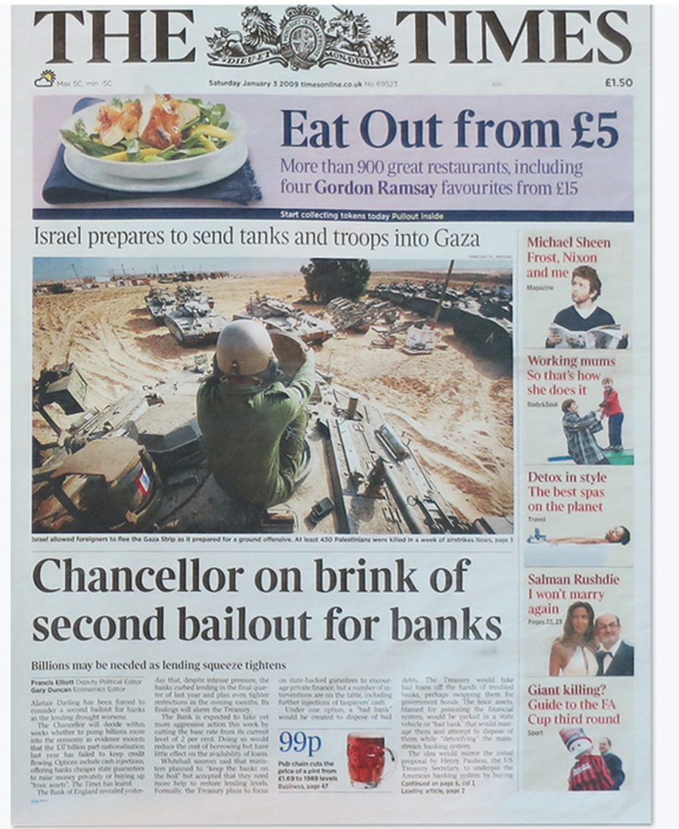

Slide 12
Cryptocurrency or CryptoAnarchy?
While this “creation myth” of the pursuit of a stable financial system may provide the explanation for the bitcoin protocol which currently dominates other digital currencies, it fis not convincing as an explanation for the creation of digital financial instruments.
Many proposals for alternative monetary frameworks focus on the anonymity provided by the growth of the internet. This approach is represented in Tim May’s “Cryptoanarchy Manifesto” which states that
“A specter is haunting the modern world, the specter of crypto anarchy. Computer technology is on the verge of providing the ability for individuals and groups to communicate and interact with each other in a totally anonymous manner. Two persons may exchange messages, conduct business, and negotiate electronic contracts without ever knowing the True Name, or legal identity, of the other. Interactions over networks will be untraceable, via extensive re-routing of encrypted packets and tamper-proof boxes which implement cryptographic protocols with nearly perfect assurance against any tampering. … These developments will alter completely the nature of government regulation, the ability to tax and control economic interactions, the ability to keep information secret, and will even alter the nature of trust and reputation.”
“Anonymous action will escape sanction and state control without the possibility of personal identification. Like a land of zombies. This raises the question of who will control information about actions. Combined with emerging information markets, crypto anarchy will create a liquid market for any and all material which can be put into words and pictures. Liquid markets in information”

Slide 13
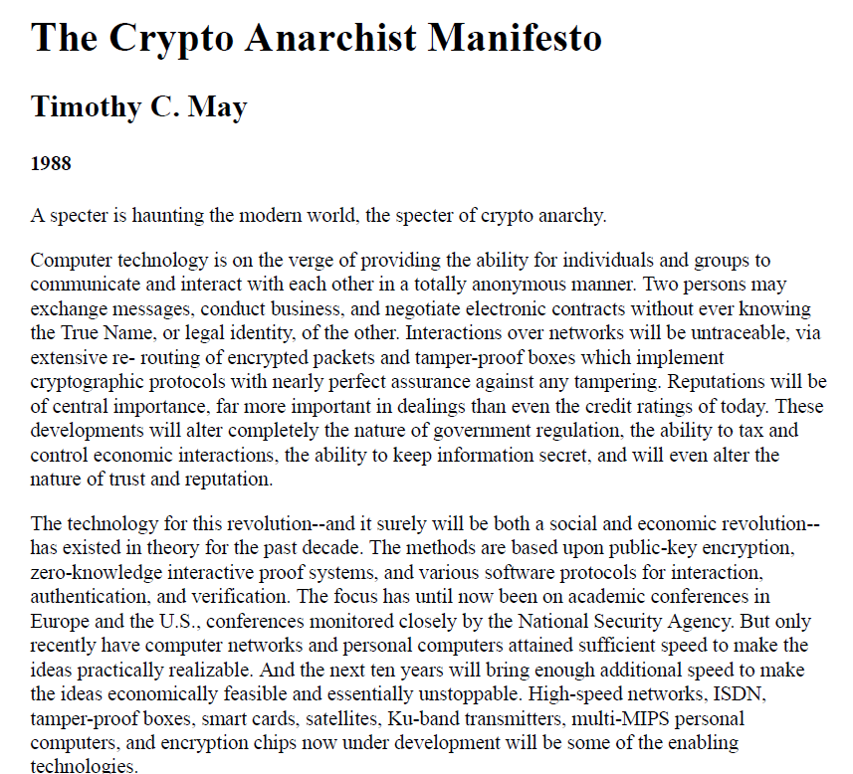

Slide 14
More or less anonymity- privacy?
But, in the development of the internet these “liquid markets” were not inherently anonymous. Indeed, their development on the basis of internet ecommerce has decreased invisibility and led to mechanisms for collecting and commercialising identity and personal information.
Indeed, only recently has the extent of identity transfer become obvious and required governments to impose privacy safeguards on participants in the global system.
Paradoxically, this expansion in private information in commercial transactions has led to the need for anonymity in the provision of crypto currency.
Robert Guttmann, writing in a 2003 book noted that the “challenge to reviving the internet as a locus of commerce “ after the dot.com collapse lies in the “question of how best to pay for purchases online.” Although there were numerous attempts to provide digital currency, he notes that “something better is needed than cash, checks, bank wires or credit cards to pay for transactions on the internet.” 86
We can thus think of ebay auction markets, started in 1995, as the prototype of direct P2P commerce which needed an equivalent payment system which elicited an initial response in 1998 Confinity which became paypal absorbed by ebay, but was superseded by crypto currencies such as bitcoin.

Slide 15
The Pre-Internet Cryptography Explanation
The very first attempt at a secure messaging system that was extended to the creation of a non-commodity money dates from the late 1960s.
Stephen Weisner, a young graduate student grappling with the implications of the Bell theorem proving non-locality in quantum mechanics proposed a perfectly secure “quantum money” which could not be copied or counterfeited.
The serial number expressed on each dollar bank note would carry a set of superpositioned photons inside special boxes. The issuing bank would insert the photons in definite states of polarization and keep a sealed record in its archives of the arrays of polarizations that went with each serial number.
Making a copy of the bill would require making measurements of each photon’s polarization. If a photon in a box had been set in circular polarization, but the counterfeiter chose to measure linear polarization instead, he would have a fifty-fifty chance of finding horizontal or vertical polarization, but not circular. For every unit of quantum currency the counterfeiter would need to know whether each photon was in a linear or circular polarization state before even attempting to make a measurement or produce a copy. The bank, meanwhile, could easily check any bill against its own records to detect fakes.
Simon Singh The Code Book

Slide 16
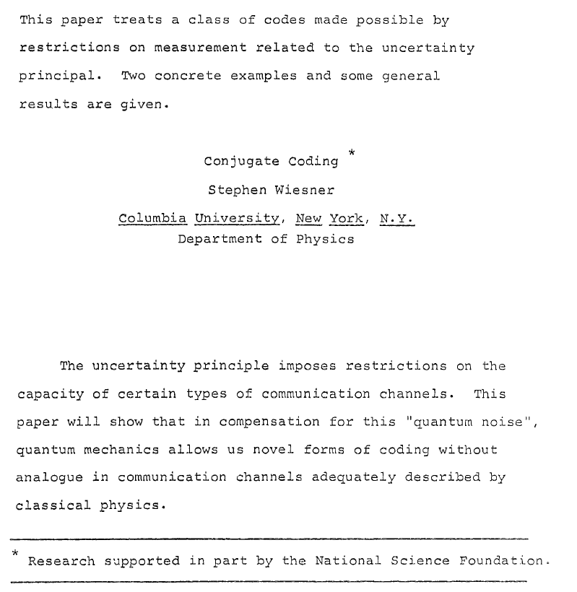

Slide 17
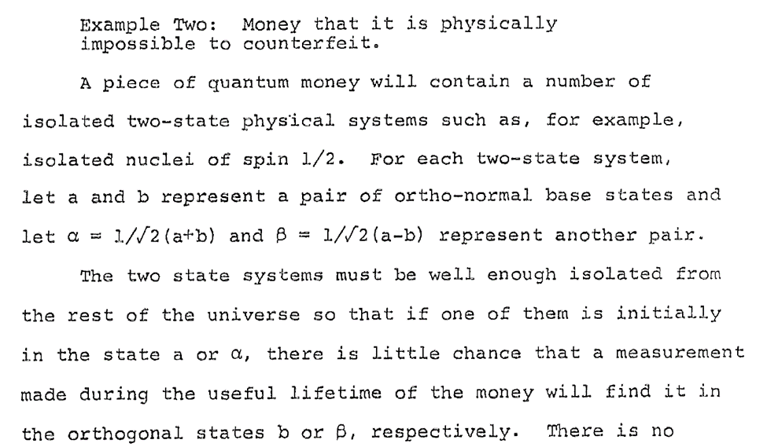
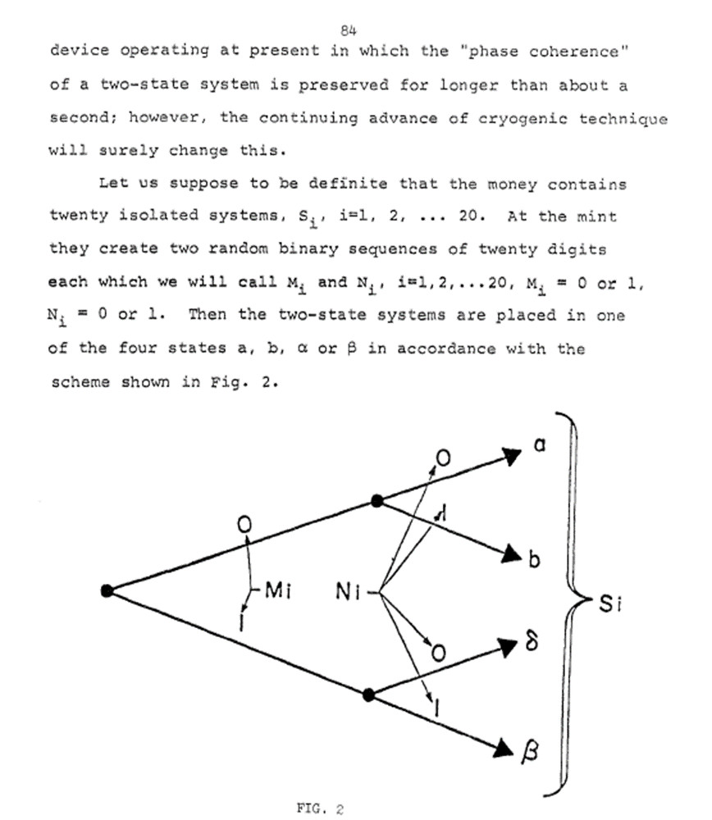
While this approach was exceedingly expensive, there was a positive application made in Vienna in April 2004 in which the city’s mayor and the director of one of the city’s largest banks collaborated with physicists from the University of Vienna and a spin-off company to produce the first electronic bank transfer using quantum cryptography. Specially prepared beams of light transmitted an unbreakable code—an encryption key—between the bank’s branch office and city hall. If anyone else had tried to listen in on the signal, the eavesdropping would have been detected easily and unambiguously.

Slide 18
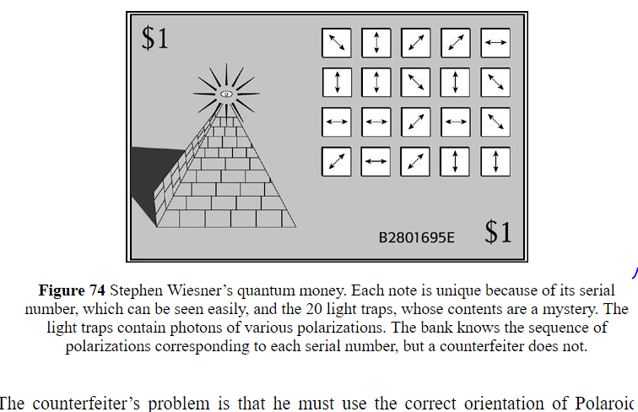

Slide 19
Diffie to RSA to Chaum: Voting and Blind Signatures
The real impetus for the cryptography that was eventually adopted by cryptocurrency developers was the discovery of one-way functions by Winfield Diffie (and we now know at least two other groups of researchers) which allowed asymmetric encryption.
This led in 1977 to development of RSA public key cryptography
In the 1980s David Chaum produced a workable untraceable electronic currency system -- digicash, derivative of his work on blind signatures to provide a voting system that could not be manipulated. As ecash it was in fact offered by Mark Twain bank where Hyman Minsky sat on its Board of Directors!

Slide 20
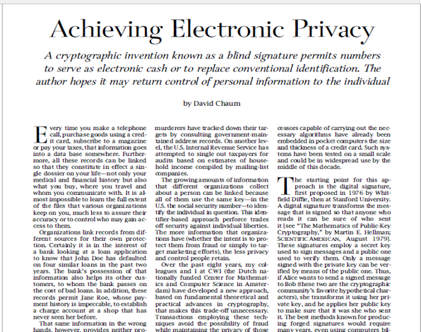

Slide 22
Two Roads: Silk Road v. P2P distributed time stamp server
Thus while May assumed that the anonymity generated by the expansion of the internet was true, Dai and then Nakamoto after him tried to create the anonymity that was presumed to exist with physical cash bank notes by replicating them with digital money.
These developments were driven by two contrasting objectives. The first was derivative of May’s Anarchic manifesto – a purely unregulated, invisible mechanism which eventually served to provide liquidity to the Silk Road of money launderers and drug dealers which operated in the deep web independently central institutions such as banks, or governments, or even other individuals. A system of non-trust which relied only on the individual.
“We’re talking about the potential for a monumental shift in the power structure of the world,” Ulbricht, still in the shadows as DPR, told Forbes, just months before he was ultimately arrested. “Sector by sector the State is being cut out of the equation and power is being returned to the individual.”
Opened in 2011, “In 2013, Silk Road founder and darknet drug emperor Ross Ulbricht, AKA Dread Pirate Roberts (DPR), seemed convinced that his website was destined to become the catalyst for a revolution. After all, his site linked nearly 4,000 drug dealers around the world to sell their wares to more than 100,000 buyers, and could you get you anything from falsified documents to heroin — even a rocket launcher.”
https://www.oxygen.com/crime-time/ross-ulbricht-silk-road-darknet-dream-market-wall-street

Slide 23
Bitcoin as small change
The other is clearly expressed by Craig Wright, who claims to have been or have been part of the group that signed itself Satoshi Nakamoto: “The promise of Bitcoin lay never in removing government. The promise of Bitcoin lay in micropayments and a system that delivered an honest ledger …One reason why I created Bitcoin is directly linked to the nature of payments and the fact that the traditional internet payment mechanisms using credit cards didn’t work for small-value transactions. Whilst large-value transactions in Bitcoin, and any related system, can be reversed, it is economically and computationally unfeasible to do so with small transactions. I never envisioned billion-dollar transactions as the use case of Bitcoin, for which it is a rather terrible system by itself. Instead, I saw the use of micropayments as small as a fraction of a cent and the ability to create small casual payments for systems such as online-gaming platforms. Such a methodology had value then, and it has value now. The Bitcoin was always designed to be, first and foremost, a micropayment system that could be extended beyond digital cash to the operation of other digital assets. …Given the state of the “cryptocurrency industry”, both are the likely outcome.
In the past, eCash and related money-transfer systems were all based on a model of anonymity, aiming to make it private through encryption. I completely turned the model on its head, by not using encryption at any point within Bitcoin

Slide 24
An honest internet distributed digital ledger
It is here that the role of internet telecommunications and the search for an honest ledger come together with cryptography.
A fair election requires verification of the individual vote but anonymity of the voter. An electronic voting system thus faces the problem of monitoring double voting.
The same problem occurs with electronic money – physical notes can be counterfeit but that can be physically verified, a digital note may be perfected replicated.
These are the types of questions that cryptography traditionally seeks to resolve, although usually reserved for government transmisstions of information.
Chaum’s problem of double voting, eliminated by blind signatures, or Weiner’s quantum money, solve the same problem as the elimination of counterfeiting, which the Bitcoin whitepaper presents as the problem of the “Double Spend”.
However, these solutions were not suitable because they relied on a central authority or government for their organization.
Counterfeiting is a problem that needs to be eliminated for digital currency to replace existing physical notes, trust in centralised authority or government is not.
The two basic characteristics of bitcoin that serve the second purpose but not the first are the blockchain and the proof of work provided by miners to convalidate non-trust in the system.

Slide 25
Authority, Reversibility, Counterfeiting and the , Double Spend
However, it is these two elements that provide the financial fragility inherent in the crypto protocol compared to the other digital cash proposals. It is perhaps paradoxical that it is in the most public aspects of the system, rather than the anonymity of the agents provided by cryptography, that the systemic problems arise.
In the bitcoin system, instead of positing a decentralized system as having an advantage because of mistrust of government, the problem is posed in terms of the reversibility of transactions.
In a traditional system this is taken care of via currency legislation:currency is defined as representing a non-recourse liquidation of a debt. Purchase of illicit goods if paid in currency, cannot be recovered in law by the rightful owner; the transaction cannot be reversed.
In the case of digital cash, not covered by currency legislation, a fraudulent transaction could be reversed if the system were run by a central authority.
“Completely non-reversible transactions are not really possible, since financial institutions cannot avoid mediating disputes The cost of mediation increases transaction costs, limiting the minimum practical transaction size and cutting off the possibility for small casual transactions, and there is a broader cost in the loss of ability to make non-reversible payments for nonreversible services. With the possibility of reversal, the need for trust spreads. Merchants must be wary of their customers, hassling them for more information than they would otherwise need. A certain percentage of fraud is accepted as unavoidable. These costs and payment uncertainties can be avoided in person by using physical currency, but no mechanism exists to make payments over a communications channel without a trusted party.”
So it is the possibility of reversal by the central authority that makes it necessary to provide an alternative mechanism of trust in the permanence of transactions.
This is what bitcoin calls the “double spend” problem, which is similar to the counterfeiting problem in prior crypto research but not exactly the same. Both can be resolved by adjudication by a central authority, the double spend is a temporal problem because it is assumed a double spend must take place sequentially, rather than simultaneously which would be possible with a digital copy of the currency. It is the time stamp recording that deals with the first problem, it is the recording in a consecutive ledger, that solves the second.
Together, the two problems are solved by a system of accountants who record and verify the temporal succession of transaction in a distributed (shared) ledger. Finally, the serial linkage of 100 consecutively registered and adopted ledgers makes any attempt to tamper with the time series of transactions of small sums to duplicate becomes excessively costly.

Slide 26
Distributed time stamp servers
The “peer to peer distributed time-stamp server” system solves the double-spend problem and the trust problem without espousing an anarchic, decentralised or social preference governance system.
Note that there is no mention made here of a “blockchain”
the only reference to “chain” is found in the definition of “an electronic coin as a chain of digital signatures.”
But, it is this verification system that embeds financial instability.
THE P2P Time Stamp Machine is also a Money Machine
Where does the digital money come from? The bitcoin world is composed of individual users, nodes and miners. Individual users create a digital identity by choosing a private key which is hashed into a public key and converted into a digital signature
Pick at random a 256 bit value which creates a private key, an additional multiplication transforms the private key into a public key, which has your private key embedded, and additional two transformation produces a digital code which is a bitcoin address. The use of one way functions in the transformations means that knowledge of your bitcoin address cannot be easily derived from your public key you’re your private key cannot be easily derived from the public key. This creates privacy, but not with the objective of hiding identity but as security for your bitcoin .
But you only have an address, you have no coin.
Where do they come from? How to you get one?
Well to start you can receive from someone who has one. A bitcoin owner signs his bitcoin with his private key and your public key and sends it to your address. At each transfer the coin acquires the recipients public key and the senders private key which is why it becomes a chain of digital signatures. You can now transfer the BTC to someone else by appending your private key and the recipients public key and sending it to their btc address. Each transmission and the btc’s historical series is made public to all who have bitcoin addresses.

Slide 27
Information network and the P2P Server
New transactions are broadcast to all nodes.
2) Each node collects new transactions into a block.
3) Each node works on finding a difficult proof-of-work for its block.
4) When a node finds a proof-of-work, it broadcasts the block to all nodes.
5) Nodes accept the block only if all transactions in it are valid and not already spent.
6) Nodes express their acceptance of the block by working on creating the next block in the
chain, using the hash of the accepted block as the previous hash.
Now, all of this is required to provide decentralized trust in the form of avoiding reversals. The transactors are anonymous, but the addresses and public keys are visible, although the objectives of the transaction are not visible but known to each recipient. The history of each coin is visible, the nodes are all visible, as are those who verify the blocks representing the transaction ledger.
So back to the question of where the BTC come from if there is no government treasury or central bank or financial institution. In the traditional system cash is created by the Treasury and allocated to the private banks from the central bank in exchange for usually a government liability. So a liqbilities on the government balance sheet, is acquired by a private bank who deposits it as collateral with the central bank in exchange for a reserve deposit which ca be converted to cash and distributed to clients who hold deposit accounts.
In the bitcoin system it is the accountants who manage the time stamp server. To manage the server they receive a payment or reward in BTC for performing what is called a “proof of work”. The work is collecting the transactions distributed by the nodes and combining them into blocks with consistent time stamps. These participants are called miners but they would have nothing to verify if there are no bitcoin..

Slide 28
The Miners Create Money out of Nothing
The paradigm story is that bitcoin should be a substitute for cash notes, or better for Gold. You get gold by owning an exploiting mine
Bitcoin is thus “earned” by “proof of work” by a “miner” who receives a coinbase “block award” (initially 50 BTC).
So you don’t need to own a gold mine but you do need a sophisticated computer system. You also need an internet connection and a source of energy to run the computer system.
Miners can create bitcoin for their own “work”.
Miners take the place of the traditional financial system.
Why do we really need miners? As noted above this is to resolve the reversal or double spend or counterfeting problem – trust.
So where did bitcoin circulating today come from?

Slide 29
Where do bitcoin come from? Genesis
The first miner – (Nakamoto?) using (Patoshi?) created the first 50 BTC coinbase (miner block reward)
The “work” was to validate a zero-BTC transaction (there weren’t any in existence yet ) which was paying himself 50 BTC, recording it in Block 0 mined on January 03, 2009 at 1:15 PM EST
The miner(s) of this block earned a total reward of 50.00 BTC The reward consisted of a base reward of 50.00 BTC with an additional 0.00 BTC ($0.00) reward paid as fees of the 0.00000000 BTC were sent in the block to the address of the miner.
This was followed by the first block which actually confirmed a transfer of BTC: number 170 sending 10 BTC of the 50 BTC fee to Hal Finney on January 11, 2009 at 10:30 PM EST. The miner(s) of this block earned a total reward of 50 BTC .
The next non-zero value transaction occurs in block 181 on January 12, 2009, followed sporadically by transactions in blocks 182, 183, 248, 545 and 546

Slide 30
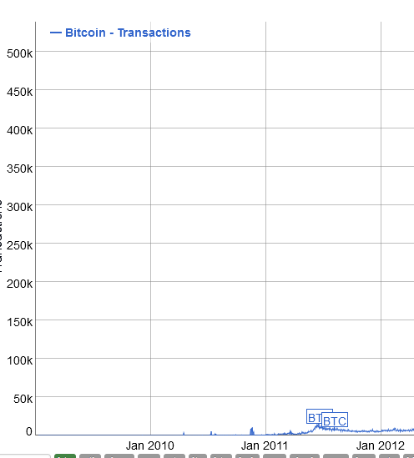
Mining profits, trx per day, top 100/total

Slide 31
Where does BTC Go?
In addition to creating BTC with coinbase rewards
Which are designed to halve every four years to eventually trend to zero
Reaching 21 million as BTC reaches the maximum limit
Since latency depends on miners’ speed in confirming transactions and validating blocks of transactions
Users may include a “Fee” for the miner of the successful proof of work to give miners and incentive to deal with their transaction first
This is a sort of “pay to play” incentive
The higher the fee the more rapid the transaction.
All BTC were initially created by miners and will eventually return to miners as transaction fees!
Bottom line: If bitcoin succeeds as a transaction currency Miners will own all outstanding

Slide 32
Can BTC ever be a small change transaction currency?
If not, can BTC survive?
What if transactions grow and replace fiat?
Supply is fixed at 21 million
by coinbase block reward halving protocol
there is no velocity of circulation,
So only response is appreciation of BTC in $
Promoted as an inflation hedge
3-4 million BTC are estimated as frozen (keys lost or technically inoperable)
19 million BTC have already been mined
Already around 2/3rds of outstanding BTC do not transact
Luna, Dai use BTC collateral for stable coins

Slide 33
Implications of a BTC deflation
Strong deflationary bias in prices denominated in BTC
Means a transfer of real income from BTC borrowers to creditors
From latecomer buyers to existing holders
From lower to higher wealth holders (miners, whales)
If transactions increase miners’ fees will end up absorbing all outstanding BTC
Not exactly friendly to the poor and unbanked
Miners’ winner curse?
Miners have a currency mismatch – they will earn declining BTC fees but have rising costs in $ fiat
BTC appreciation has to grow faster than inflation in $ mining energy costs
Would lead to even more rapid miner pool concentration and miner holdings
Half of blocks are currently mined by top 4 mining pools
51% concentration of work power (CPU)
How do miners retain value of BTC if they hold all BTC
Fork or change the source code to secure dominance of miners?
Or miners float their equity on traditional markets?

Slide 34
The Hodl Throdl

Slide 35
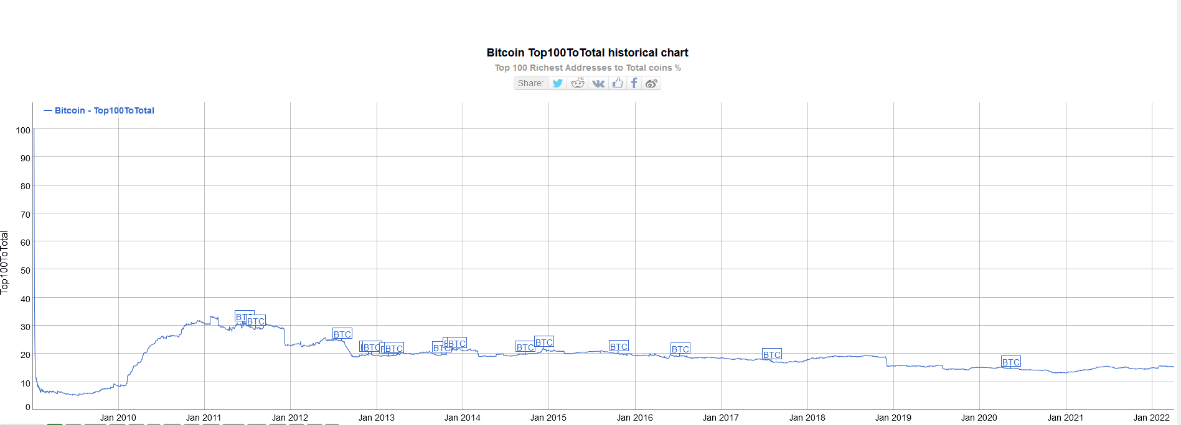

Slide 36
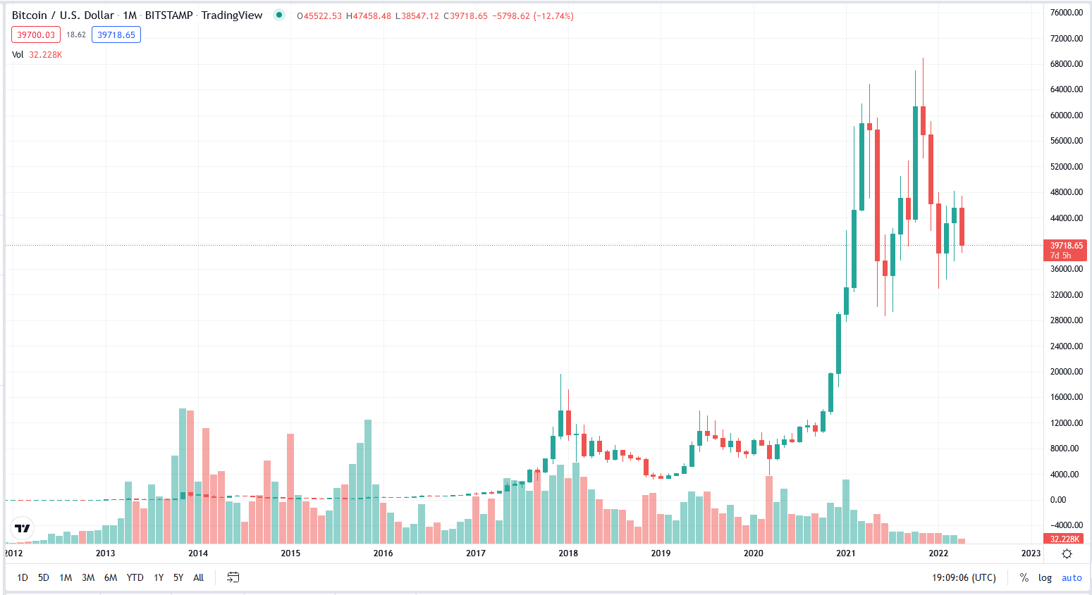

Slide 37
Cryptoverse: Wildcat Banking
Wildcat Banking in US:Banknotes issued with no collateral
Silvergate Bank, announced a $205 million interest only term loan under its Silvergate Exchange Network Leverage program to MacroStrategy LLC, a subsidiary of MicroStrategy Incorporated secured by bitcoin held in MacroStrategy’s collateral account with a custodian mutually authorized by Silvergate and MacroStrategy.
MacroStrategy will use the loan proceeds to purchase bitcoins
A BTC loan hedged with bitcoin!
BTC becomes the “reserve currency” in crypto land!!

Slide 38
A study by the finance broker found that more than two thirds (64%) of those who have invested in cryptocurrencies used one or more credit facilities to do so.
People aged between 18 and 24 were the age group most likely to use borrowed funds to make their crypto investment, with 70% of this age group borrowing to invest compared to 25% of those aged over 65.
KIS Finance found that more than a third (35.5%) of borrowers used a credit card to purchase cryptocurrencies, while almost a fifth (19.3%) funded the purchase out of their overdraft.
“It’s concerning that so many people have turned to borrowed funds to purchase cryptocurrencies as they are extremely unpredictable and offer no guarantees that the money invested will be returned. So, if people are spending money that they don’t have, and losing it, this could cause some serious financial challenges later down the line.
“The biggest concern is whether people will have the ability to pay the money back. With a very strong possibility of losing the money for good, people may be left severely out of pocket and racking up interest on their credit cards and overdrafts. Also, some credit card providers will view this type of transaction as a cash advance, meaning a cash advance fee and higher interest rate will be applied.”

Slide 39
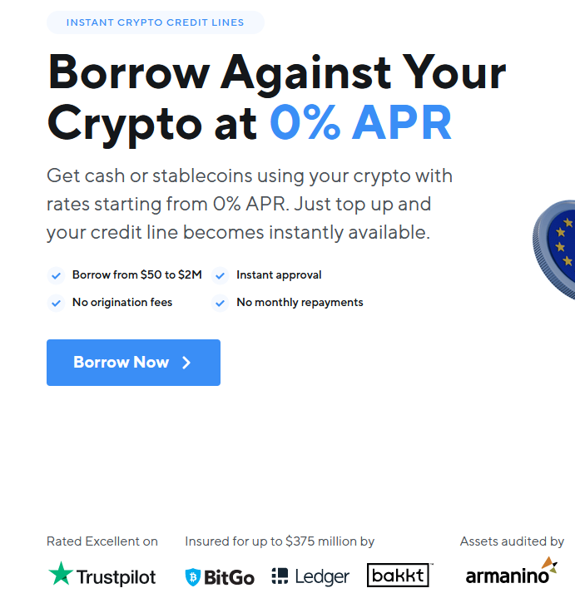

Slide 40
Exchanges mill $ for their own coins
Move your money forward
Allocate into a crypto-based investment that is fully secured by bitcoin collateral and earn higher yield compared to traditional bank rates and many fixed income markets. Circle Yield is built with USD Coin (USDC), the leading dollar digital currency.
How does Circle Yield work?
Your USDC is lent to Circle Bermuda and invested with one or more of our investment partners. These partners lend in the crypto capital markets to generate yield. The interest you receive is subject to the terms of your loan.
Your loan will be secured by our interest in bitcoin collateral received from our investment partners, initially overcollateralized and subject to top-up obligations, deposited with a third-party custodian designated in the line of credit agreement.

Slide 41
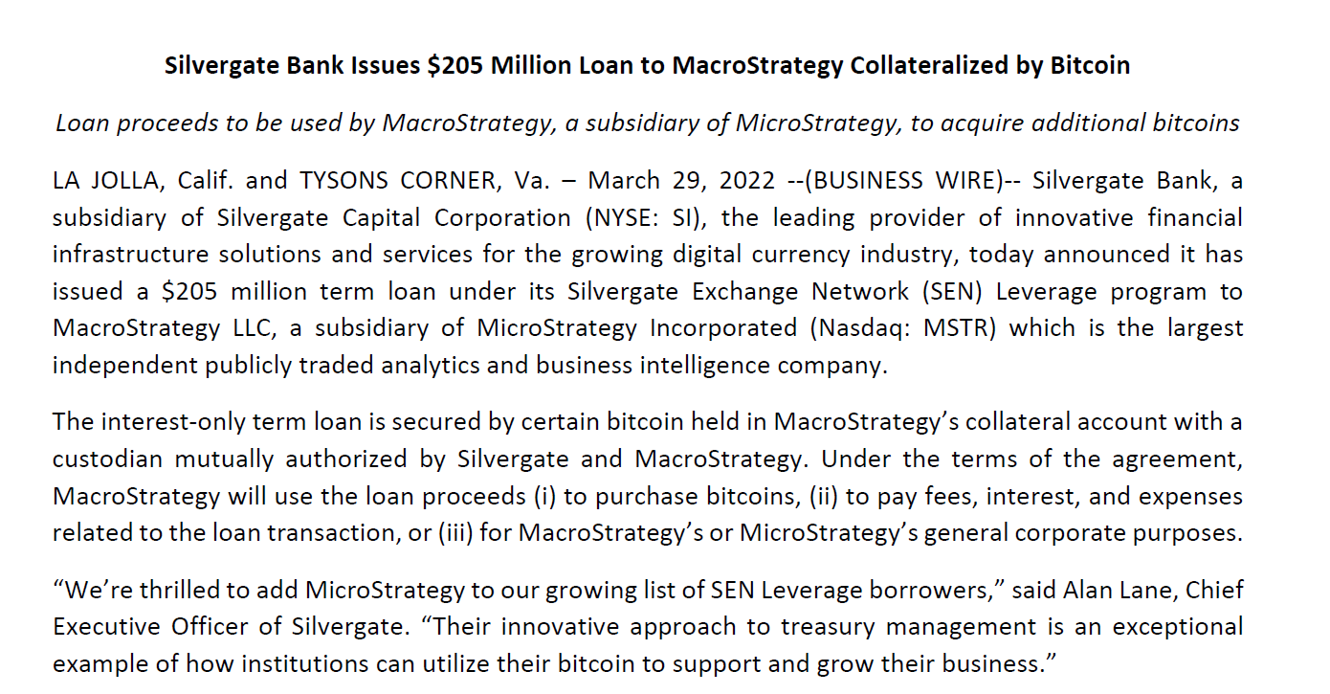

Slide 42
Market Structure: Exchanges – Stable Coins
the vast majority of Bitcoin transactions between real entities are for trading and speculative purposes. Starting from 2015, 75% of real bitcoin volume has been linked to exchanges or exchange-like entities such as on-line wallets, OTC desks, and large institutional traders. In contrast, other known entities are only responsible for a minor part of total volume.
For example, illegal transactions, scams and gambling together make up less than 3% of volume.
The fraction of volume explained by miners is even smaller.
Exchanges not only generate the most volume, but they are also the most connected nodes in the Bitcoin network. Furthermore, a large fraction of exchange volume consists of cross-exchange flows.
The high cross-exchange flows are the consequence of the current market structure.
Different from traditional, regulated exchanges, cryptocurrency markets consist of many non-integrated and independent exchanges without any provisions to ensure that investors receive the best price when executing trades. As a result, the consistency of the Bitcoin price across exchanges depends on arbitrageurs and speculators who trade across them. In support of this idea, we show that exchanges that trade similar currency pairs have higher cross-exchange flows.

Slide 43
Creating Money out of Nothing: Tether
This is not what Schumpeter had in mind
Stablecoins == MMMFs
Transaction Details Blockchain Tron Type Mint
Amount 1,000,000,000 USDT ($1,000,000,000 USD)
Timestamp (Wed, 30 Mar 2022 14:43:15 UTC)
Hash 193df027d669c1b9f4e1272966a029a35bc1dc42aa8f4953194c3ce512194def
Address Tether Treasury (Exchange)
TBPxhVAsuzoFnKyXtc1o2UySEydPHgATto
Circle has also launched in to stable with … BTC collateral!!

Slide 44
What about CBDC? Or a USTDC
Since Fed not geared up for individual account management
current proposals (FRB Boston/MIT) to test logistics favors substitute Federal Reserve Notes and Reserve Deposits with digital accounts that supplement traditional banks Reserve accounts at the Fed.
to get the CBDC you go through the same circus as getting cash
Like national bank notes in the National Banking System
There used to be a systems to do this: The Post Office
There are also working systems based on mobile telephony – e.g. webtel.mobi
Since cash is furnished by the Treasury to the Federal Reserve Banks – why not have the Treasury/OCC do this directly?
There is no “run” risk or solvency risk with a Government issue DC
Who needs the Fed?
Who needs the FDIC?

Slide 45
jankregel.org

